Slide 1
An NSS Audio-Visual
Library Presentation
Wakulla Springs 1987
S743 140 Slides 2/13/2021

Slide 2
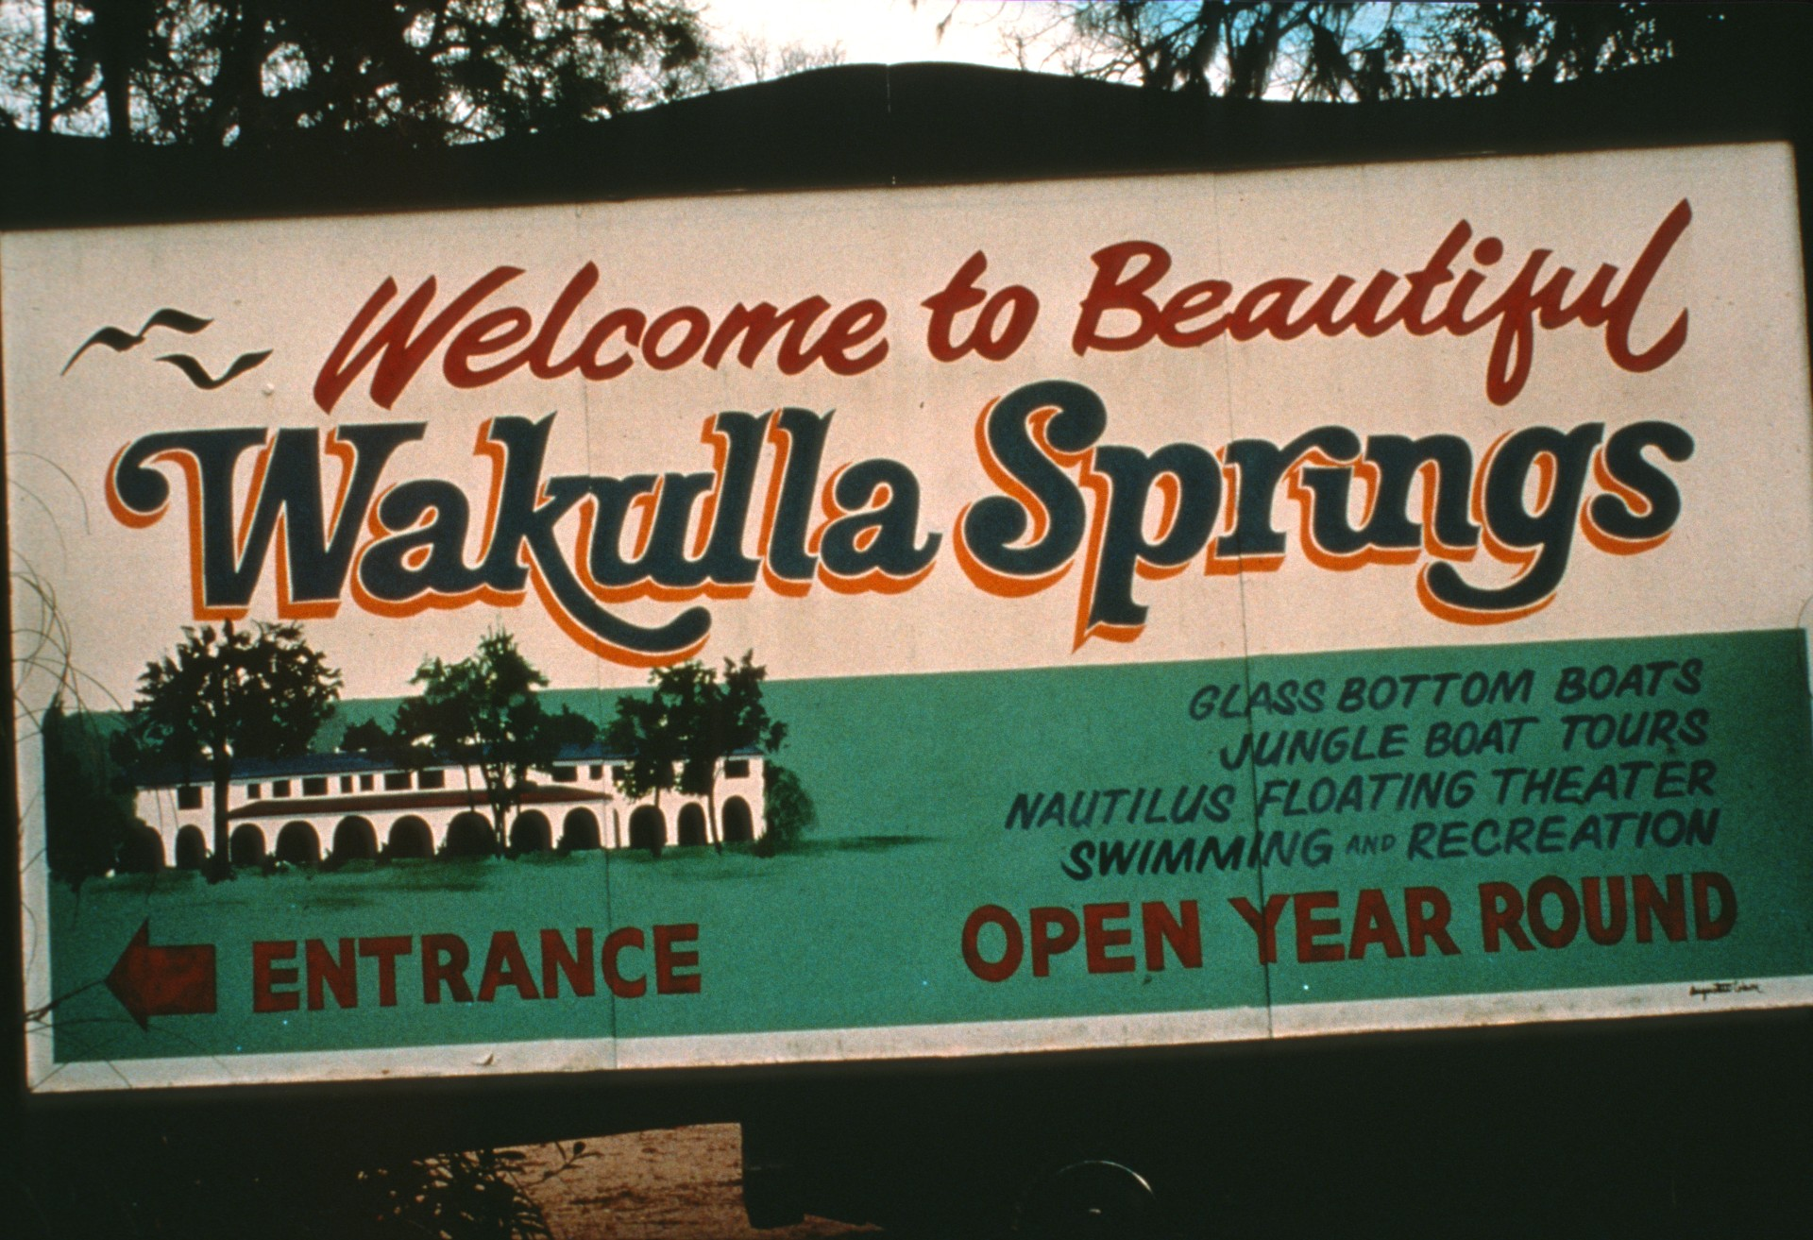
Notes:
Welcome to Beautiful Wakulla Springs! Signpost greeting visitors at the park entrance. Formerly owned by financier Edward Ball, Wakulla Springs was purchased by the State of Florida in 1986 as part of its park system. (Tom Morris)

Slide 3
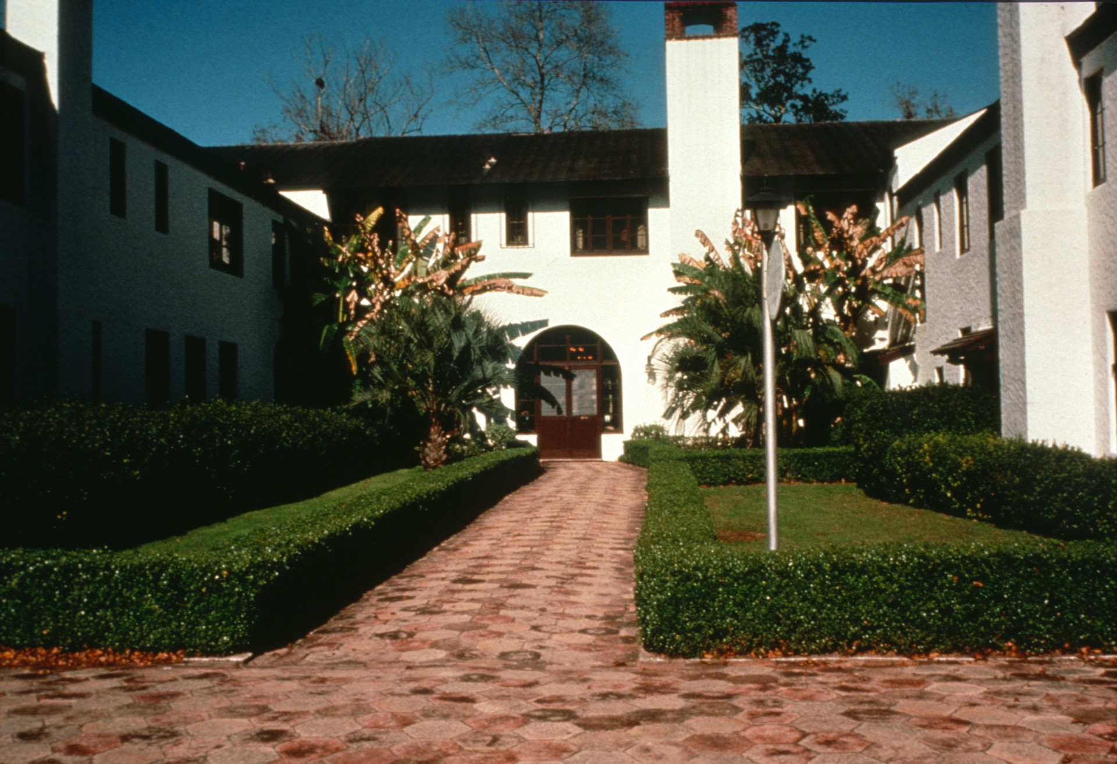
Notes:
Entrance to Wakulla Lodge, a Mediterranean Revival style lodge, first opened to visitors in 1937 by Ed Ball. (Gavin Newman)

Slide 4
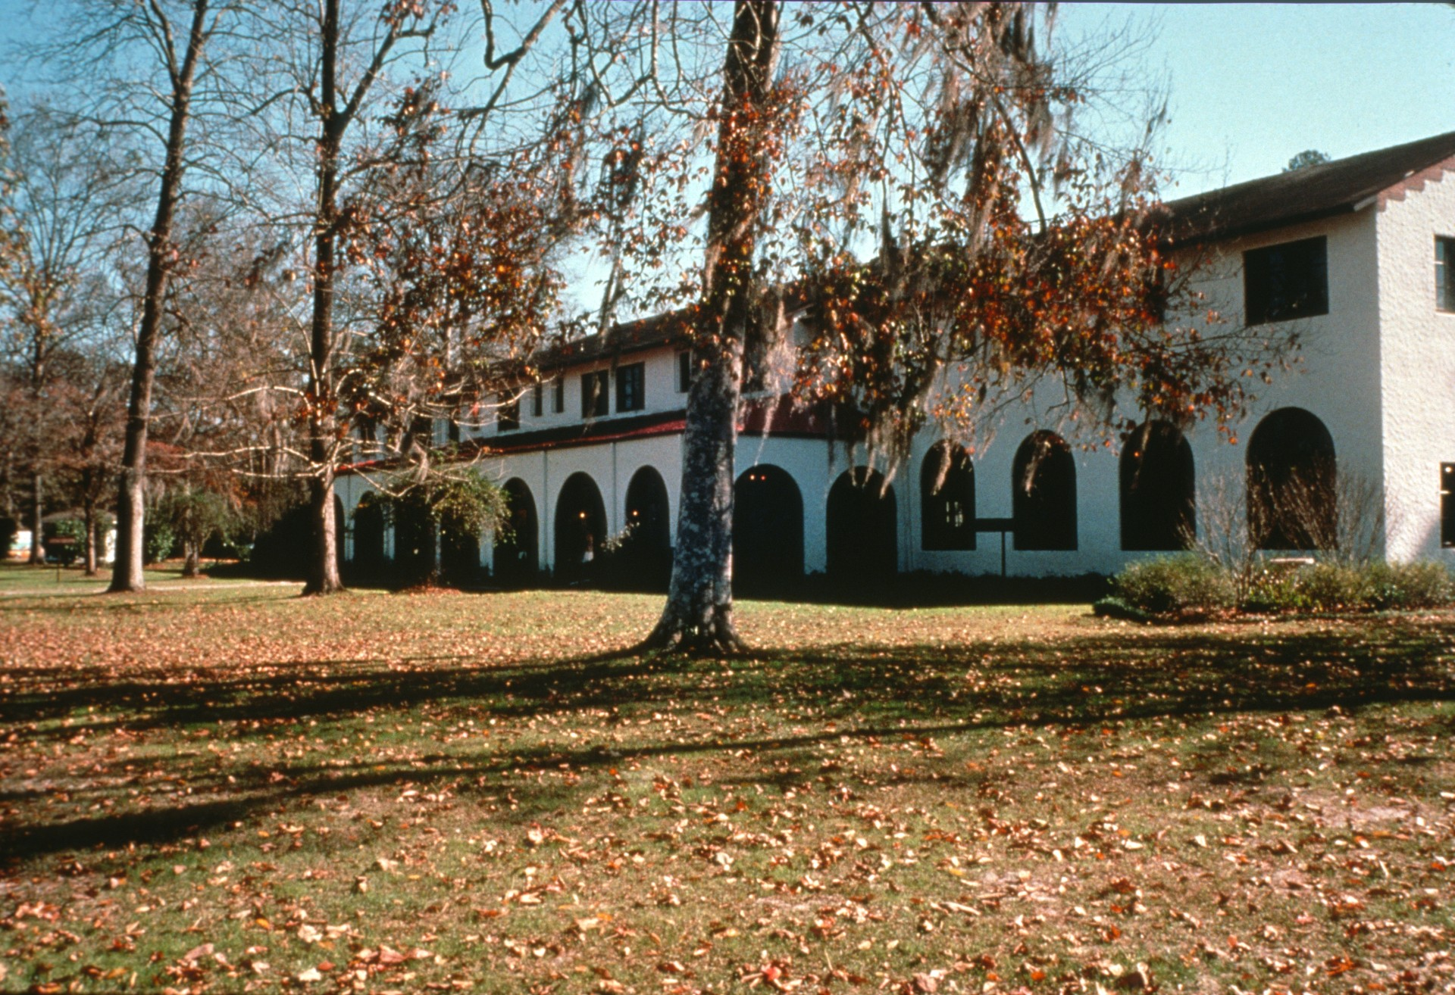
Notes:
View of the north side of Wakulla Lodge, facing the spring. (Gavin Newman)

Slide 5
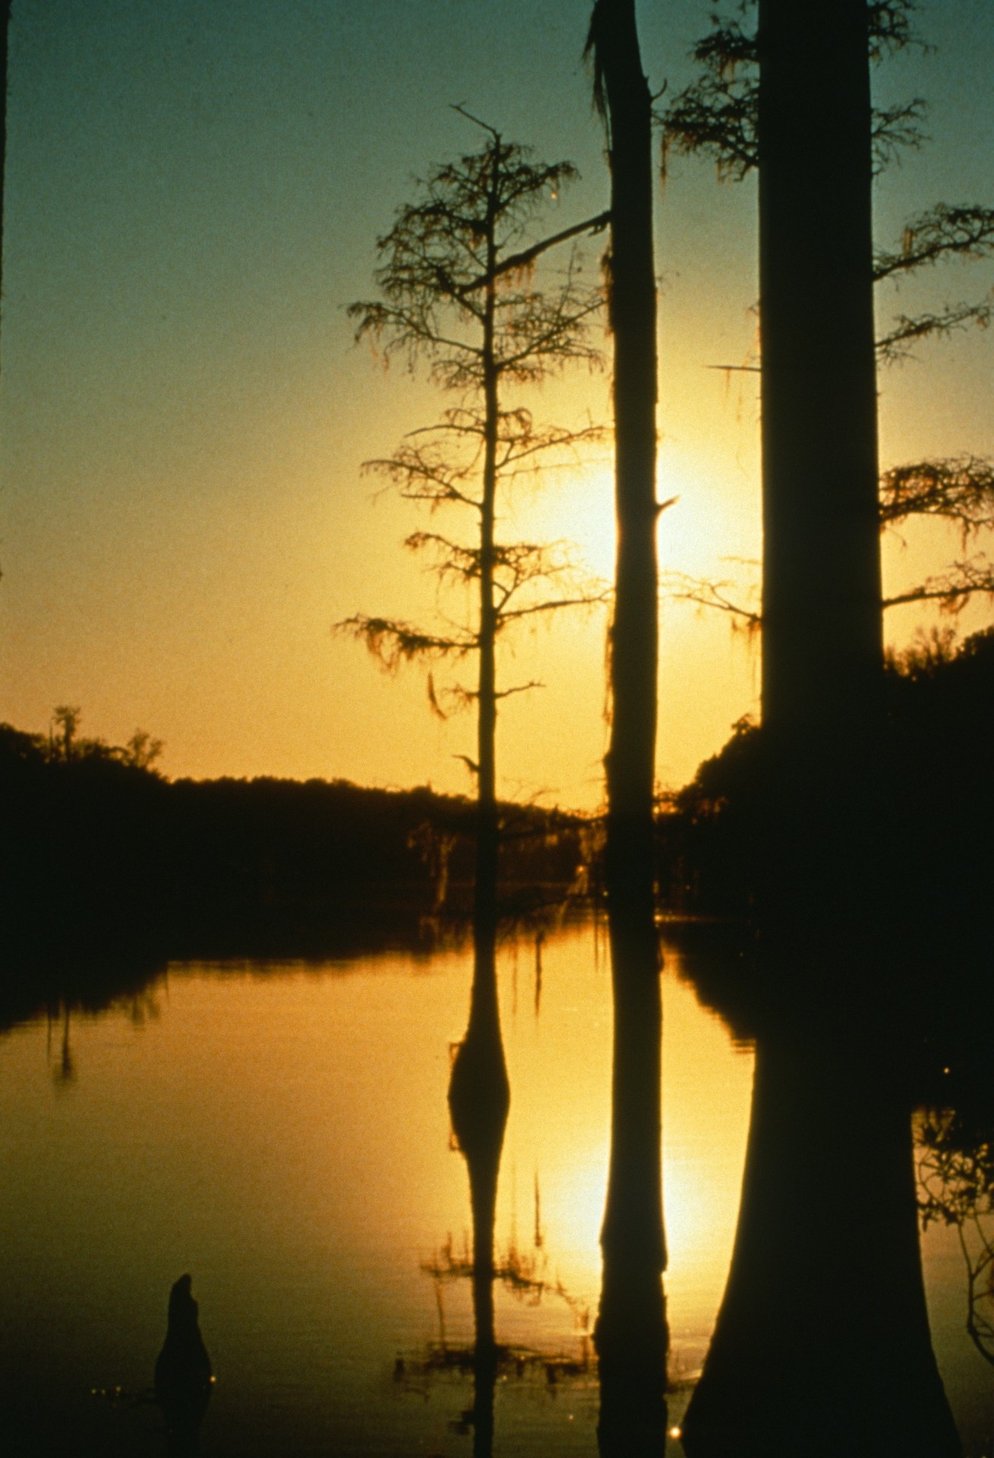
Notes:
Wakulla Springs at dawn. (Sergio Zambrano)

Slide 6
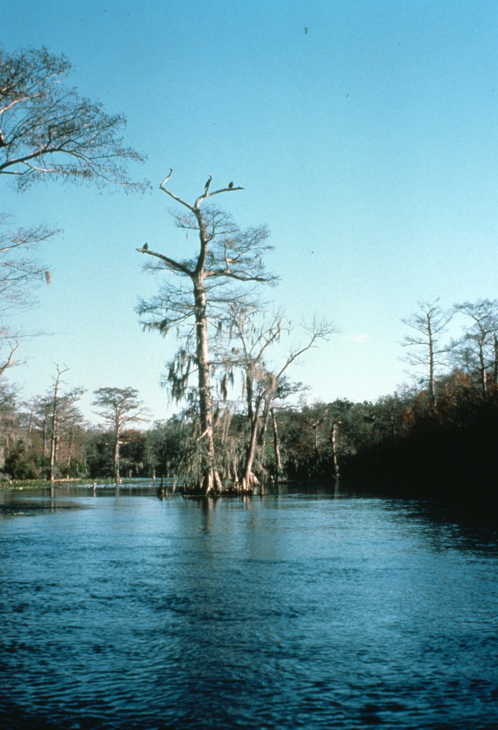
Notes:
Travelling down the Wakulla River on the "jungle cruise” tour boats operated at Wakulla 5prings since the 1930s. (Gavin Newman)

Slide 7
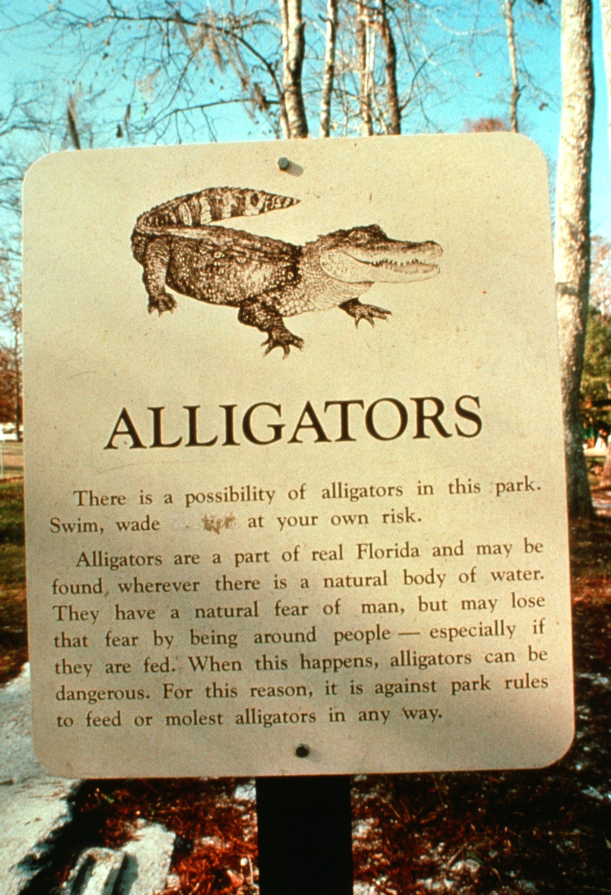
Notes:
Alligators: the Wakulla Springs State Park is a wildlife sanctuary for dozens of endangered species. We had to deal with ‘gators on several dives. (Bill Stone photo)

Slide 8
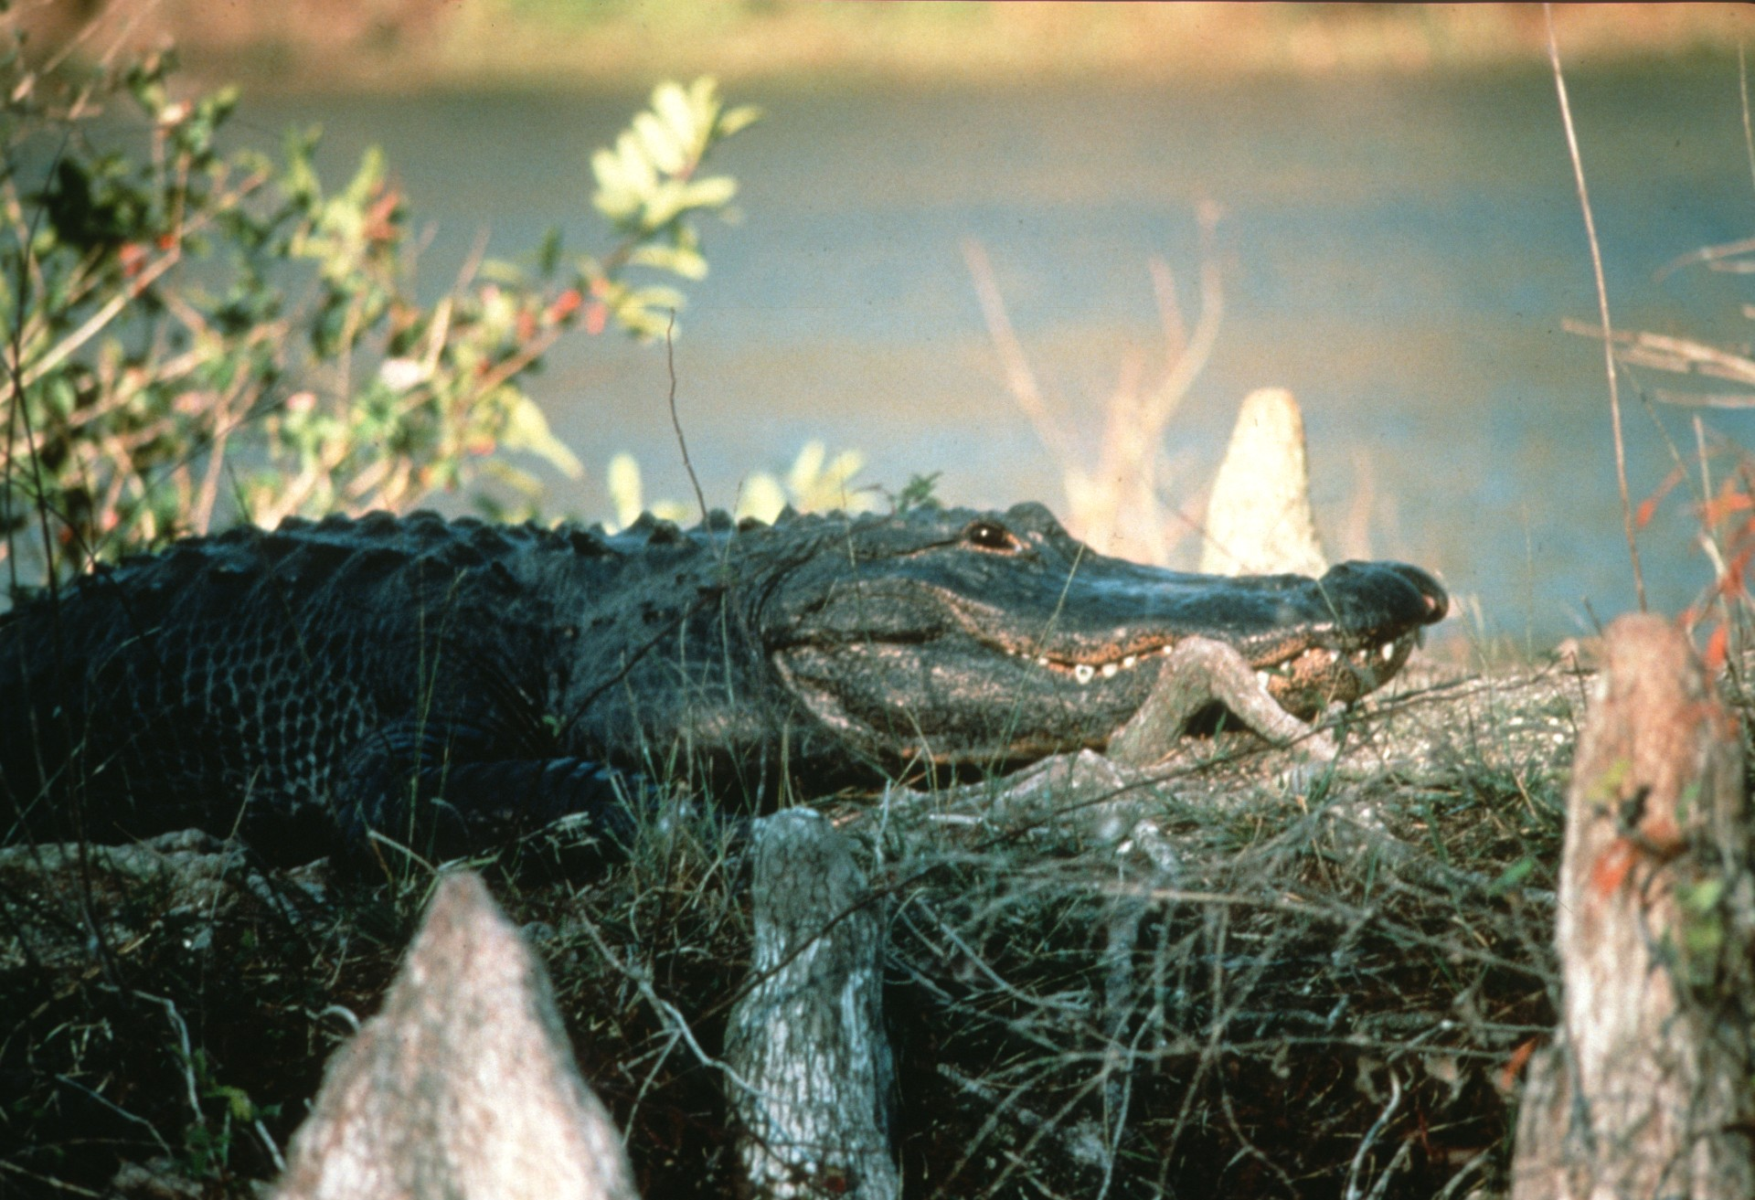
Notes:
(Gavin Newman)

Slide 9
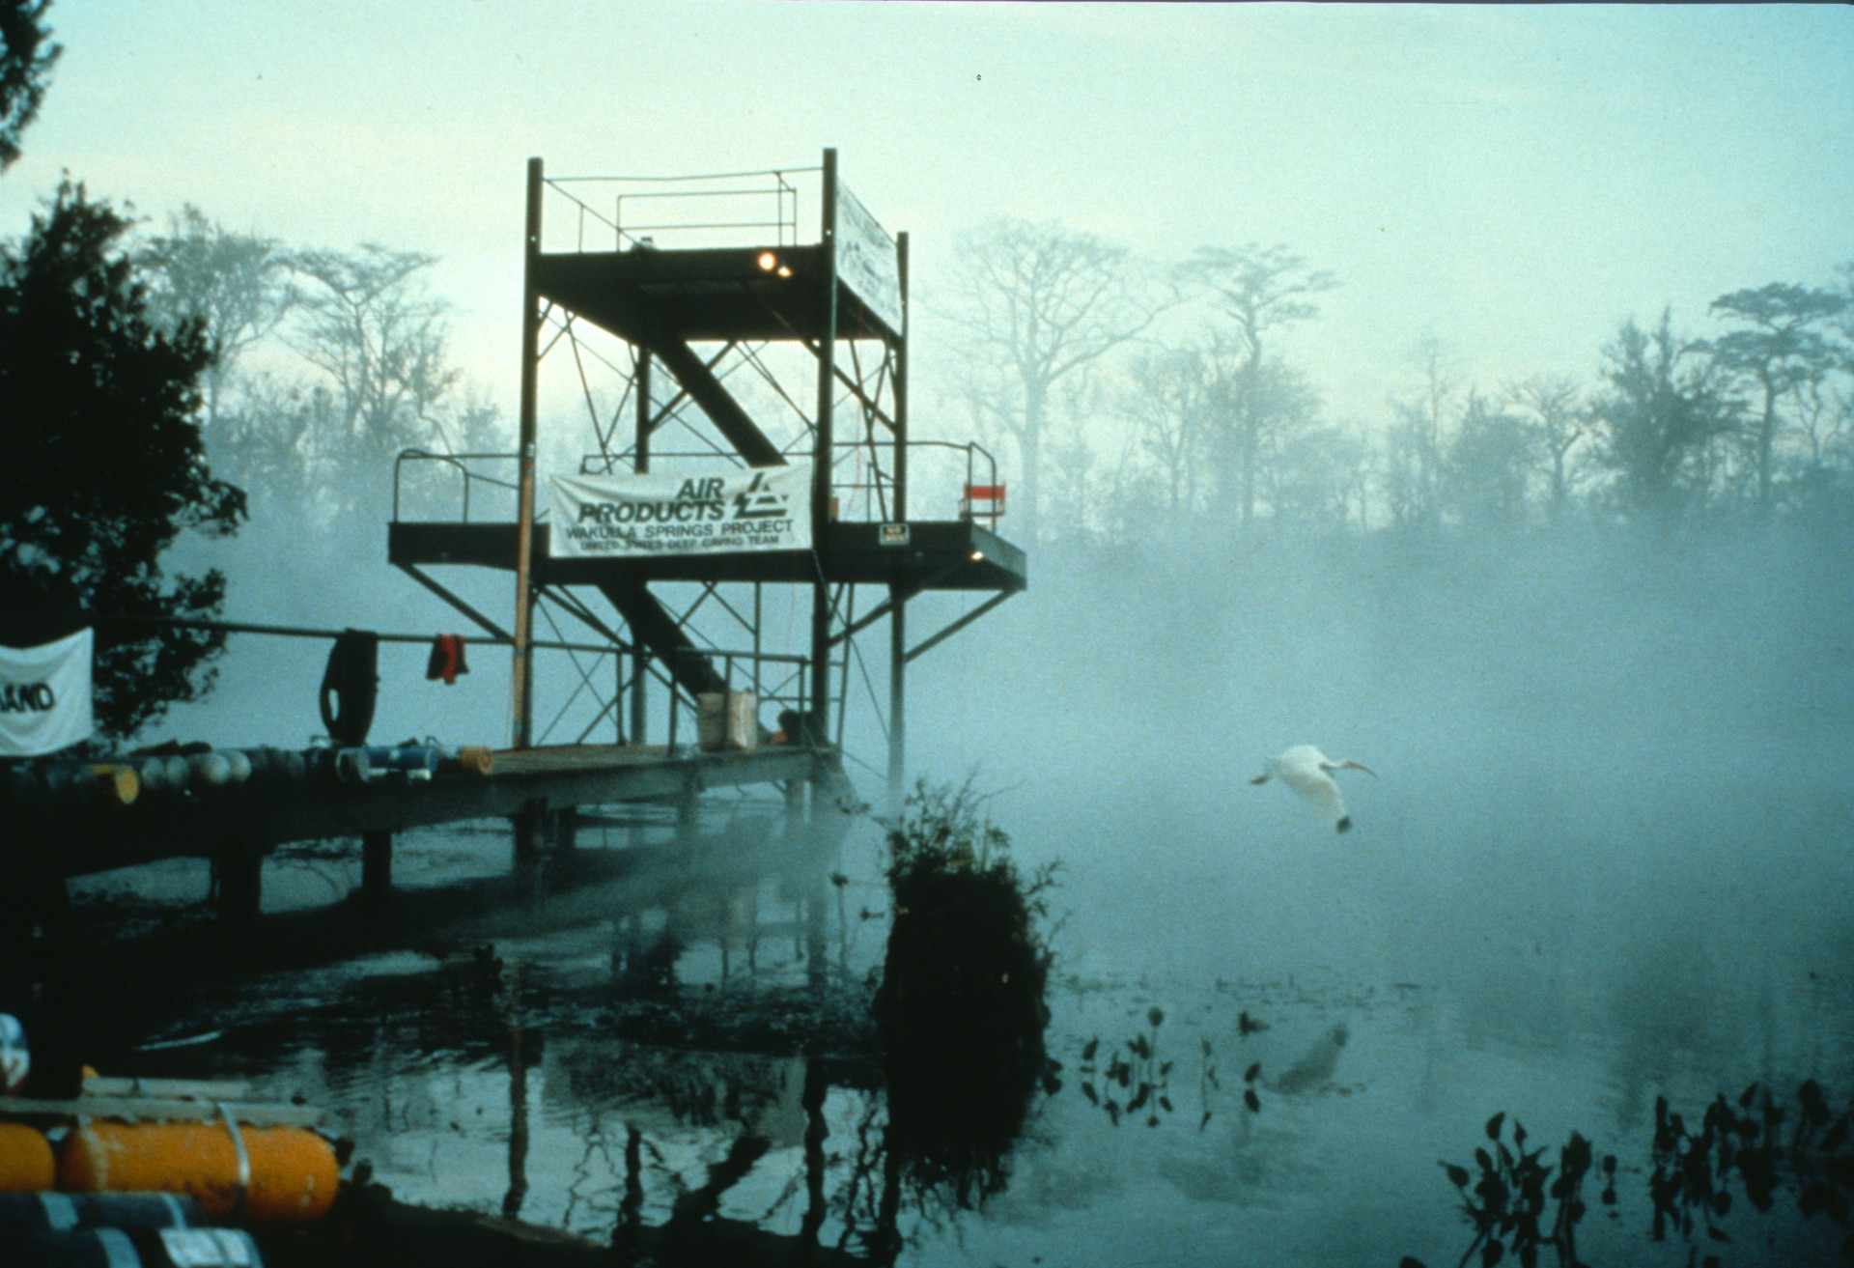
Notes:
An Anhinga silently glides through the mist at dawn near the diving tower at Wakulla Springs. The diving tower was used as the surface operations base during all dives which made use of the habitat. (Bill Stone)

Slide 10
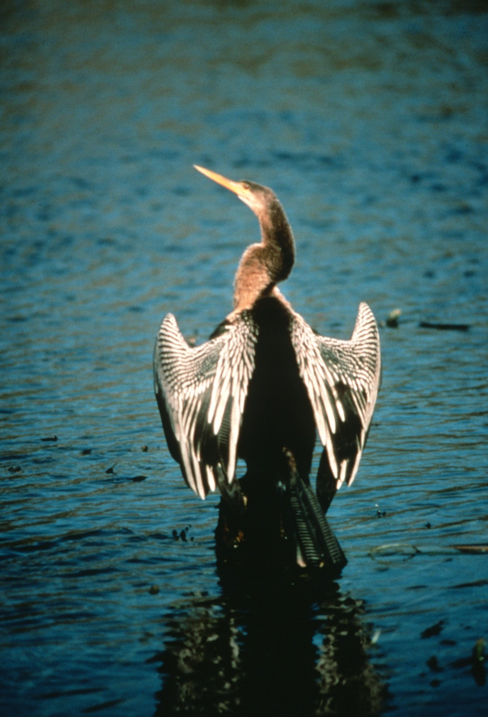
Notes:
On the banks of the Wakulla River and Anhinga spreads its wings to dry. (Gavin Newman)

Slide 11
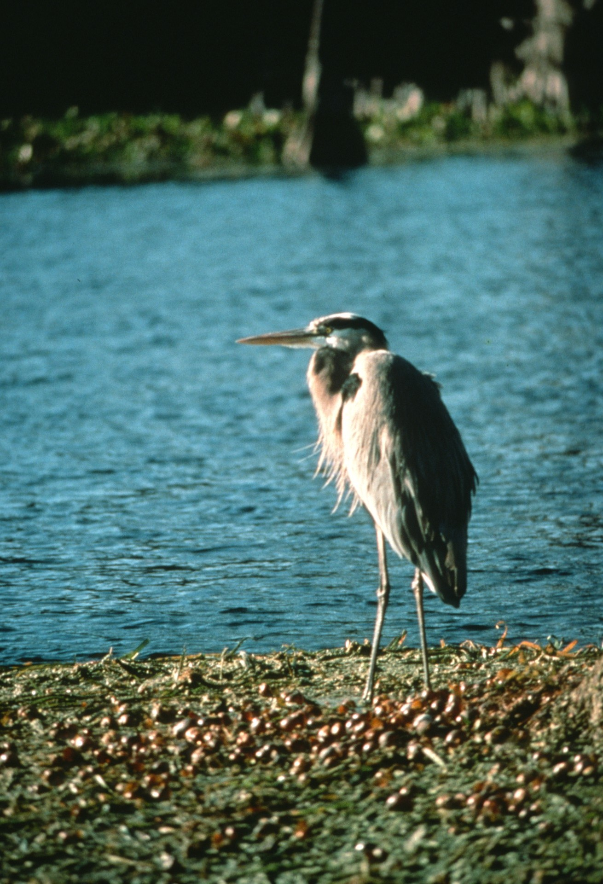
Notes:
An egret strolls the shore of the Wakulla River. (Gavin Newman)

Slide 12
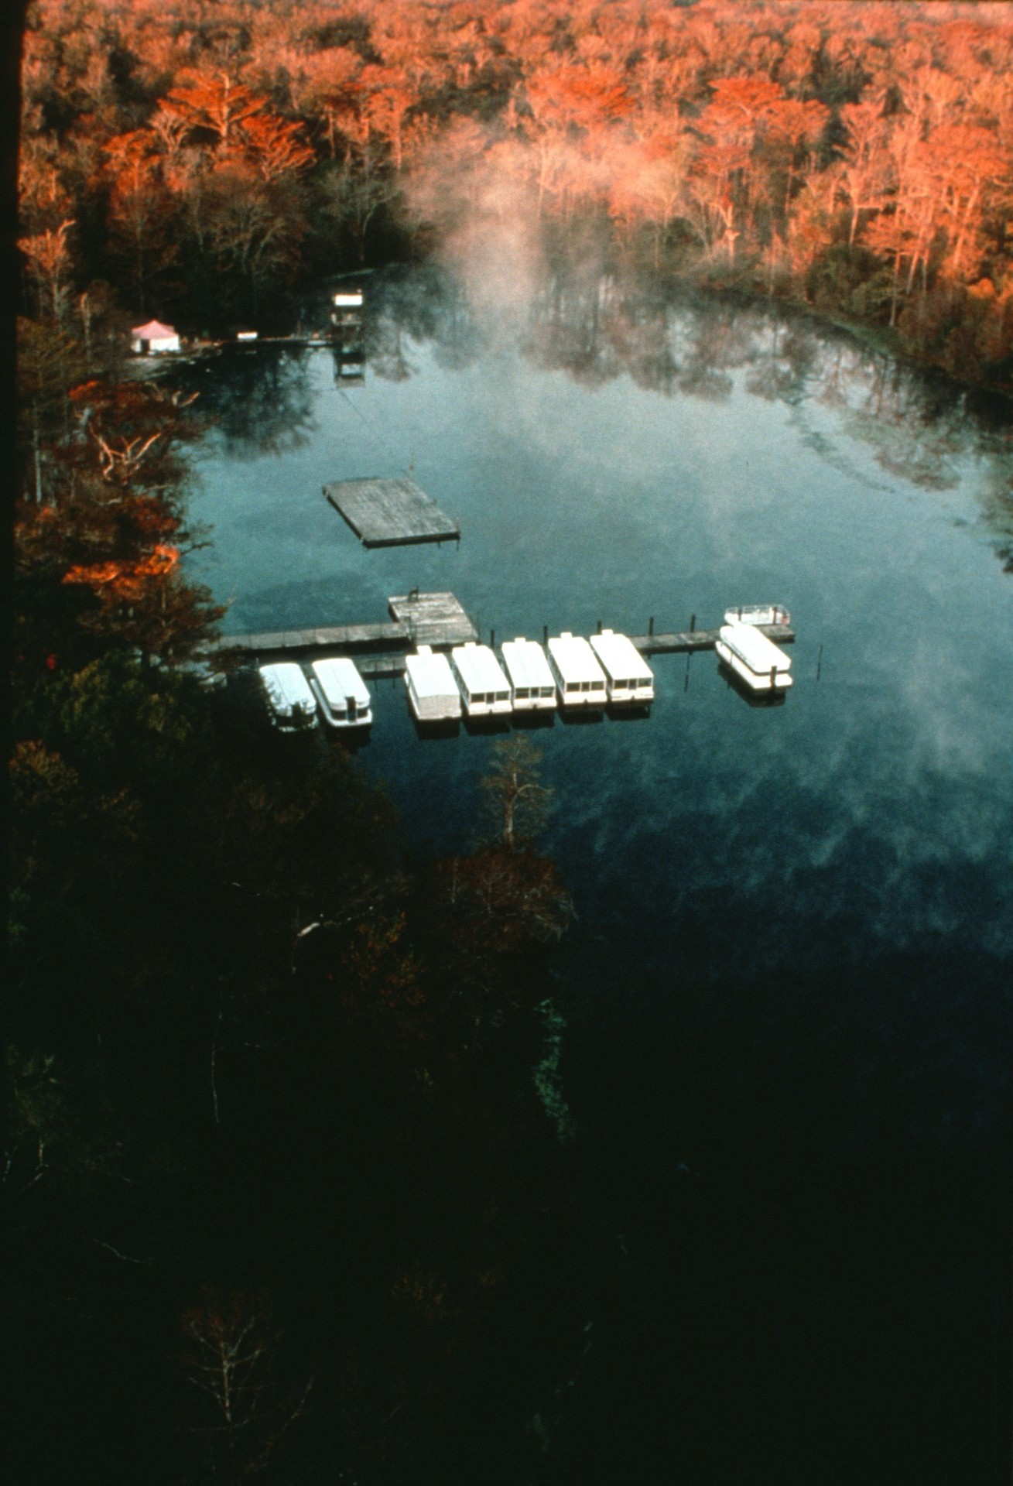
Notes:
Aerial view of Wakulla Springs at dawn. Glass-bottom boats await tourists for the famed “jungle cruise” and “glass-bottom boat tour.” (Carl Ganter/National Geographic Society)

Slide 13
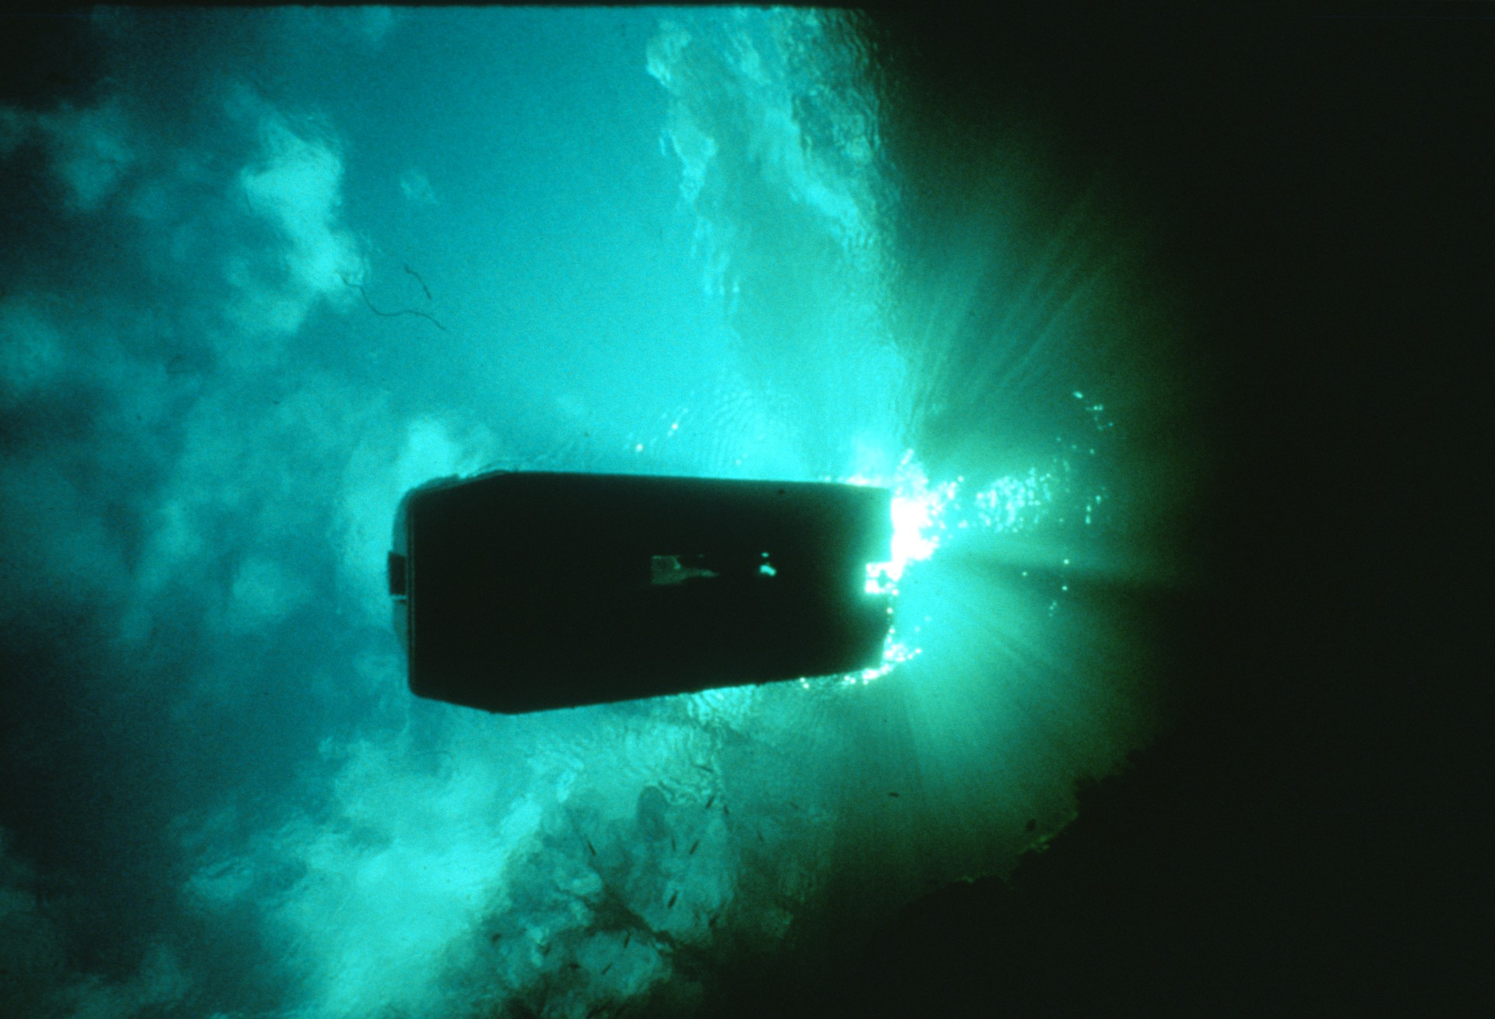
Notes:
Historic glass-bottom boat tours are still a part of daily activities at the park. (Gavin Newman)

Slide 14
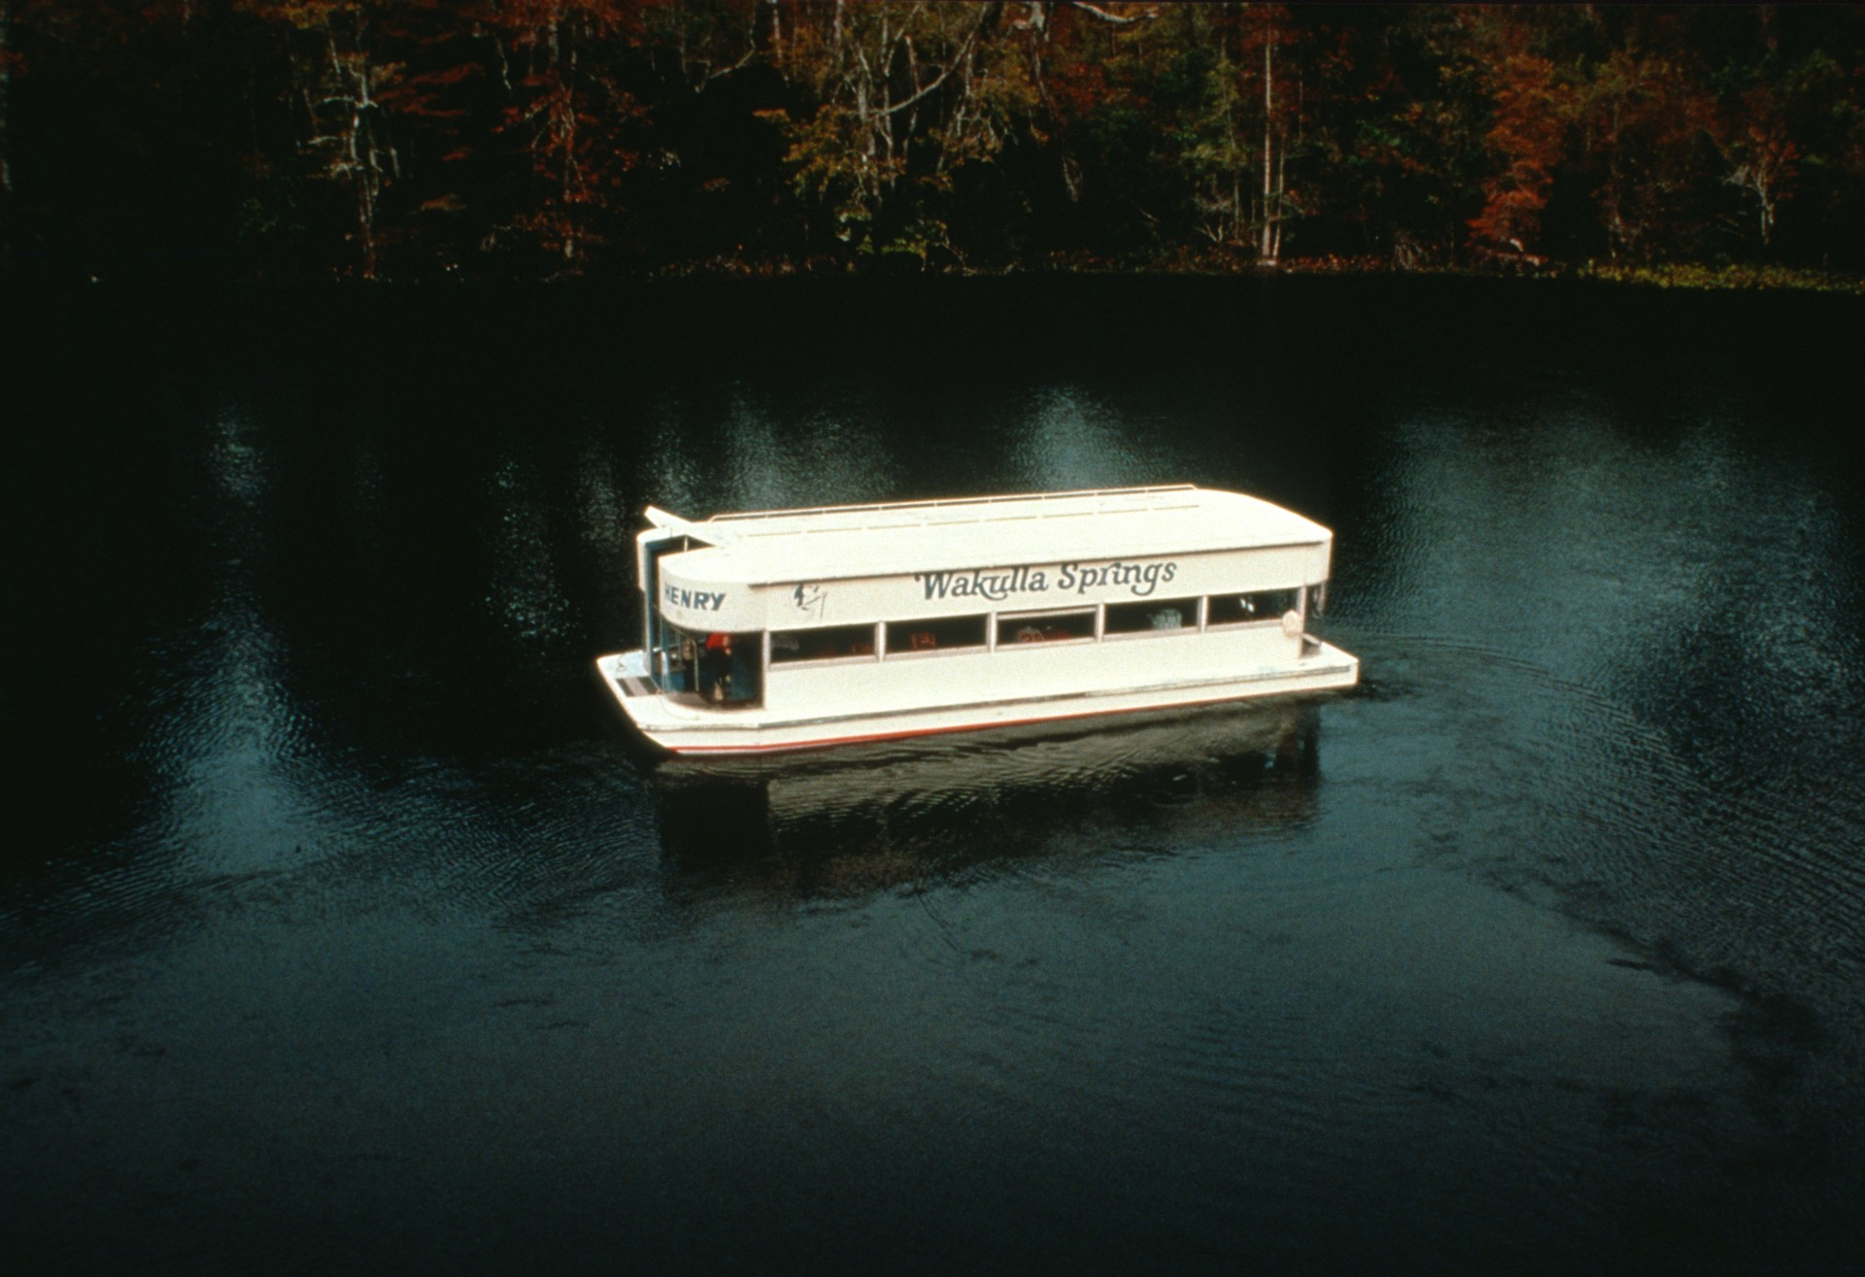
Notes:
The "Osprey” takes visitors on a glass-bottom boat tour of Wakulla basin. (Bill Stone)

Slide 15
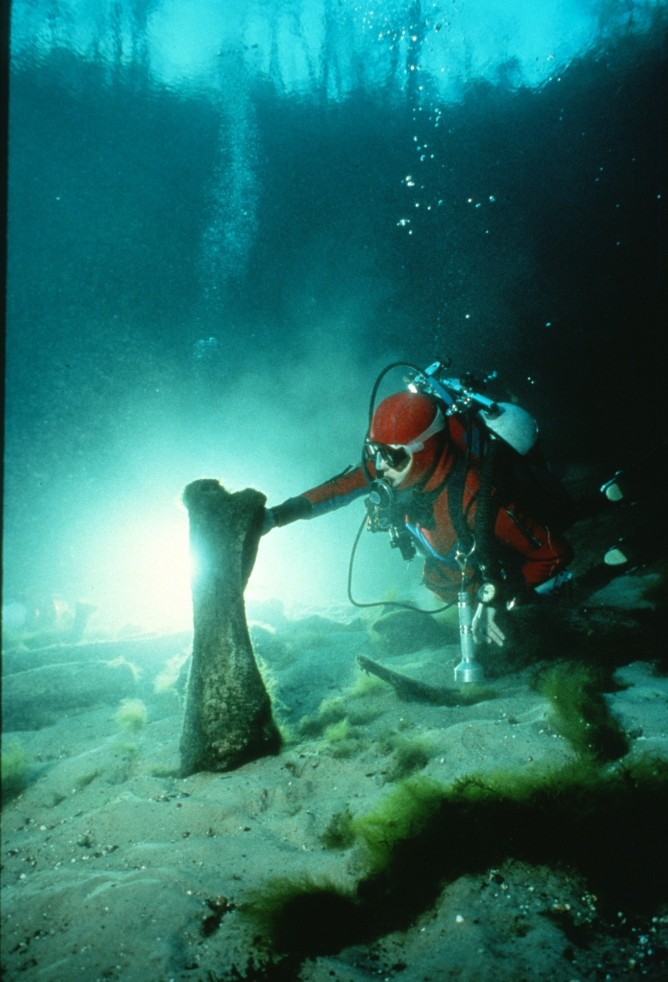
Notes:
Mastodon bones, first discovered in 1850, may still be found on the northeast side of Wakulla basin at a depth of only 30 feet (Wes Skiles)

Slide 16
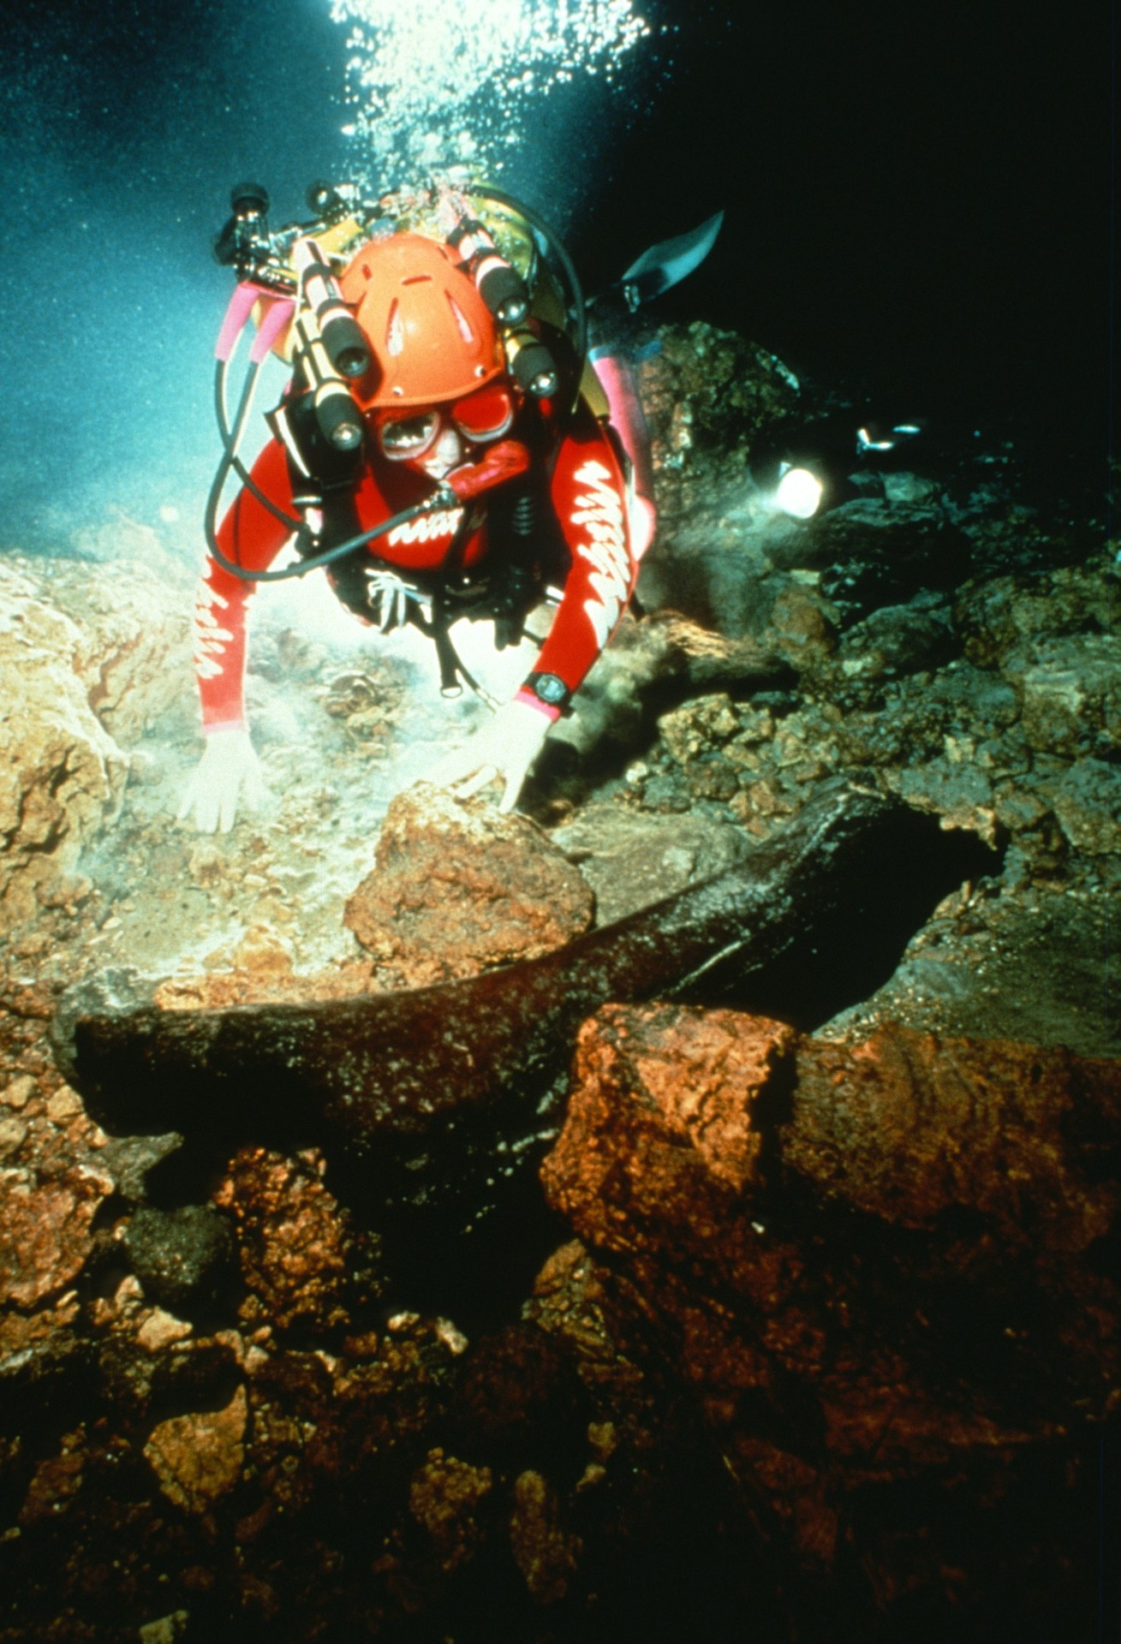
Notes:
More than 100 years ago Wakulla Springs was brought to the attention of the scientific world by the discovery of an Ice Age mastodon skeleton lying in the shallow depths of the spring. Since then, three complete skeletons have been recovered from the spring. This slide shows an intact thigh bone at a depth of 220 feet inside the spring, discovered in 1955. Our expedition discovered two additional extensive bone deposits at more than 1500 feet inside the cave at 300-foot water depth. (Gavin Newman)

Slide 17
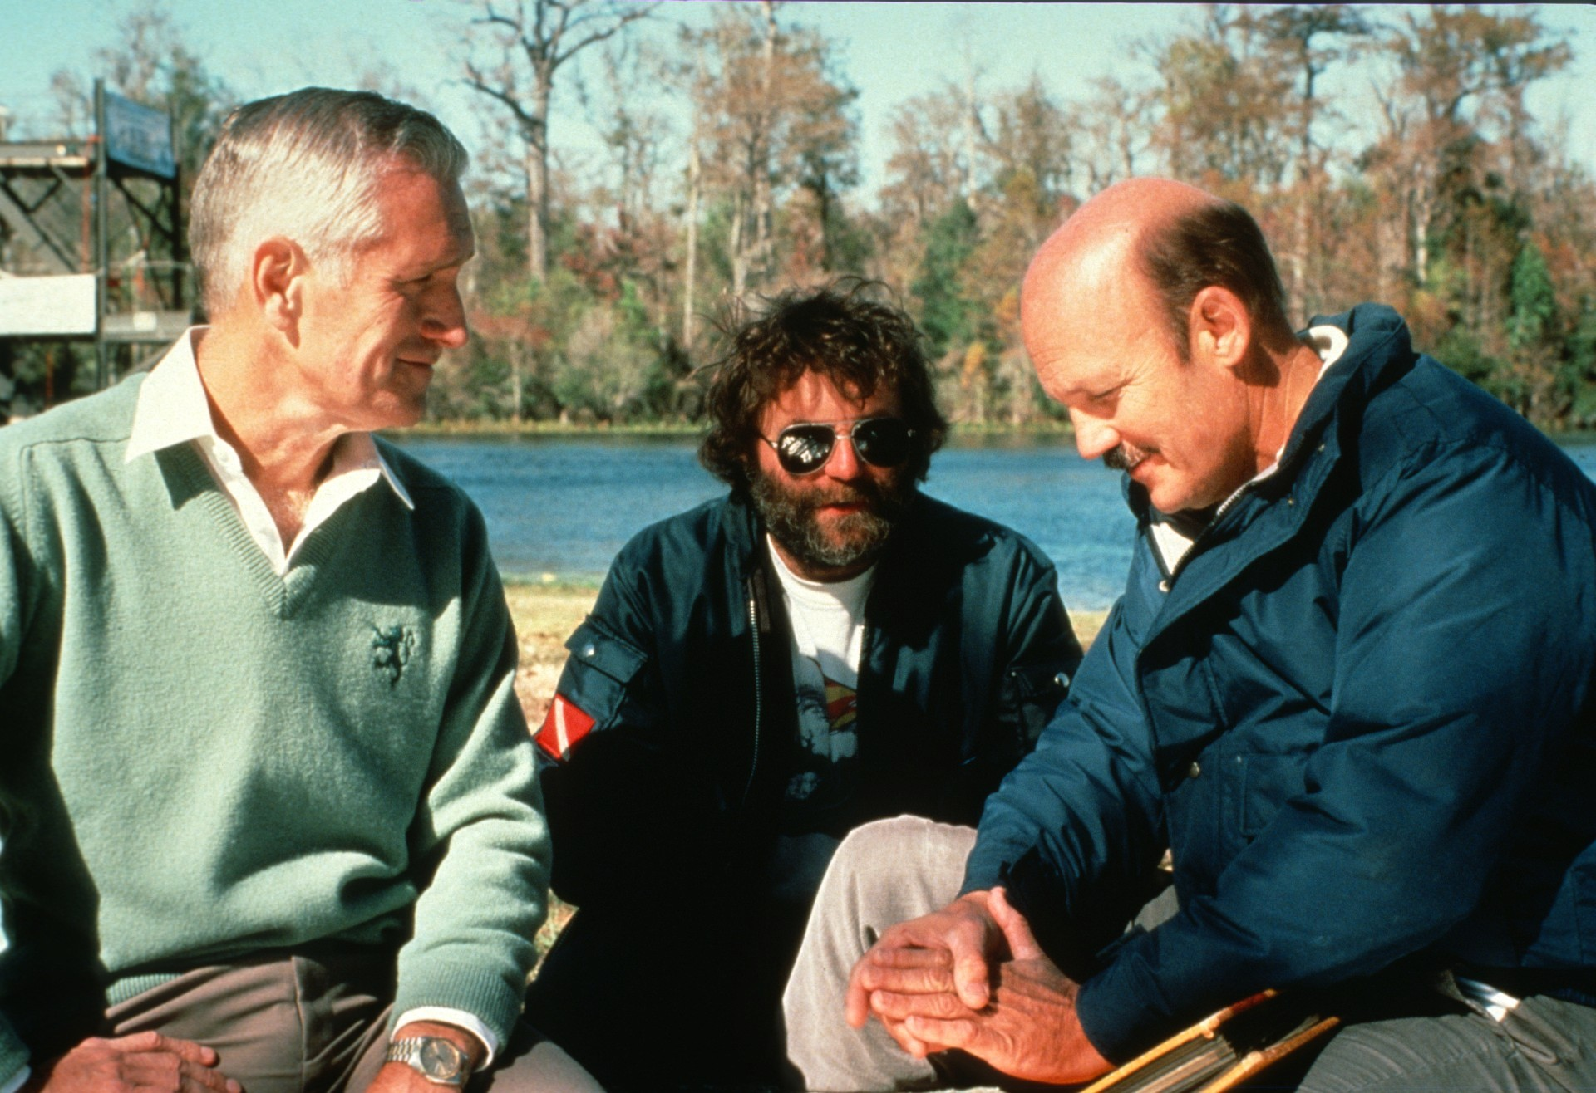
Notes:
During the 1950s divers Gary Salsman (left) and Wally Jenkins {right) led explorations into Wakulla Spring to a distance of 750 feet from the entrance at a depth, phenomenal for their day, of 250 feet. Here cinematographer Leo Dickinson (center) briefs Salsman and Jenkins during the filming of the Wakulla Springs documentary film. (Gavin Newman)

Slide 18
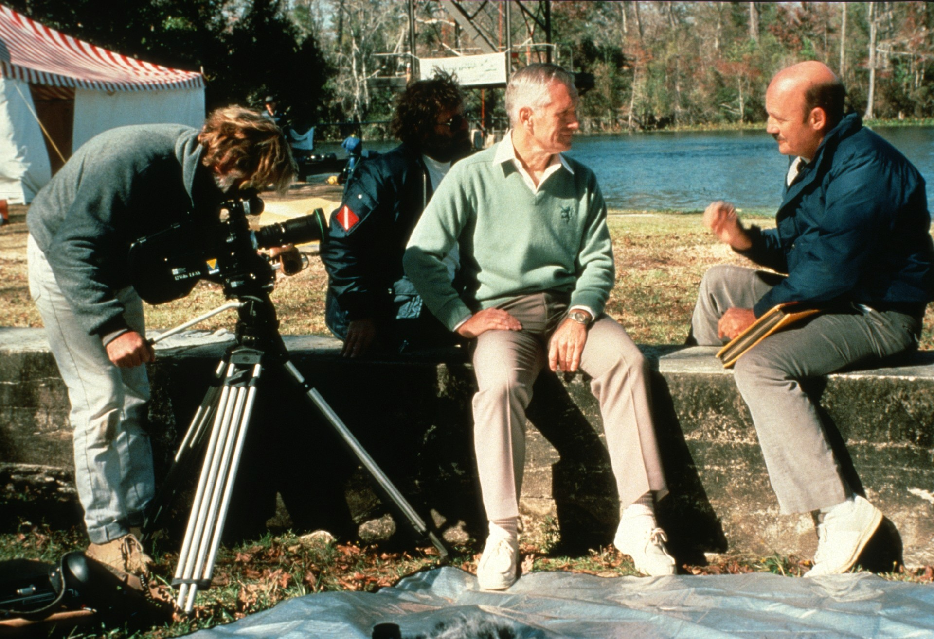
Notes:
Camera man Pete Scoones films the interview With Salsman and Jenkins (Gavin Newman)

Slide 19
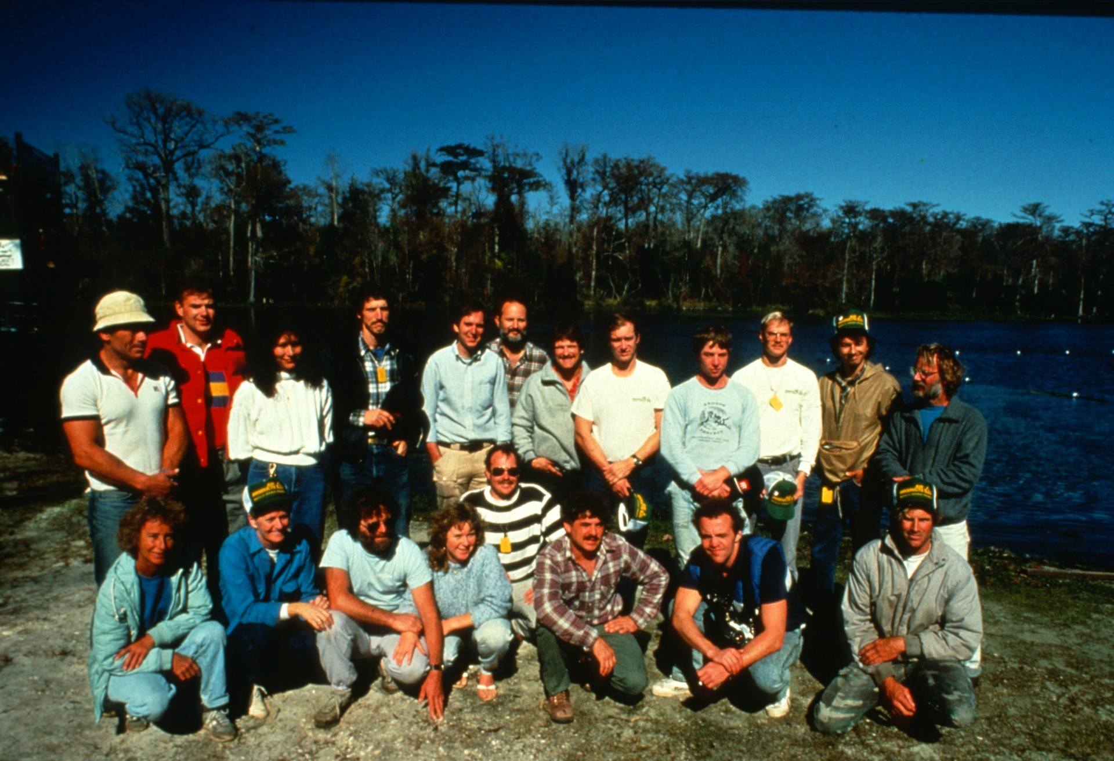
Notes:
Team photo. (l to r, rear): Angel Soto, Paul DeLoach, Tara Tanaka, Bill Stone, Dale Sweet, Sergio Zambrano, Sheck Exley, Noel Sloan, Rob Parker, Clark Pitcairn, Chris Brown, Pete Scoones. (1 to r, front): Georgette Douwma, Mary Ellen Eckhoff, Leo Dickinson, Kandy Dickinson, Wes Skiles, Paul Heinerth, Gavin Newman, Brad Pecel. Not pictured, Pat Stone, Tom Morris, Tex Chalkley. (Wes Skiles)

Slide 20
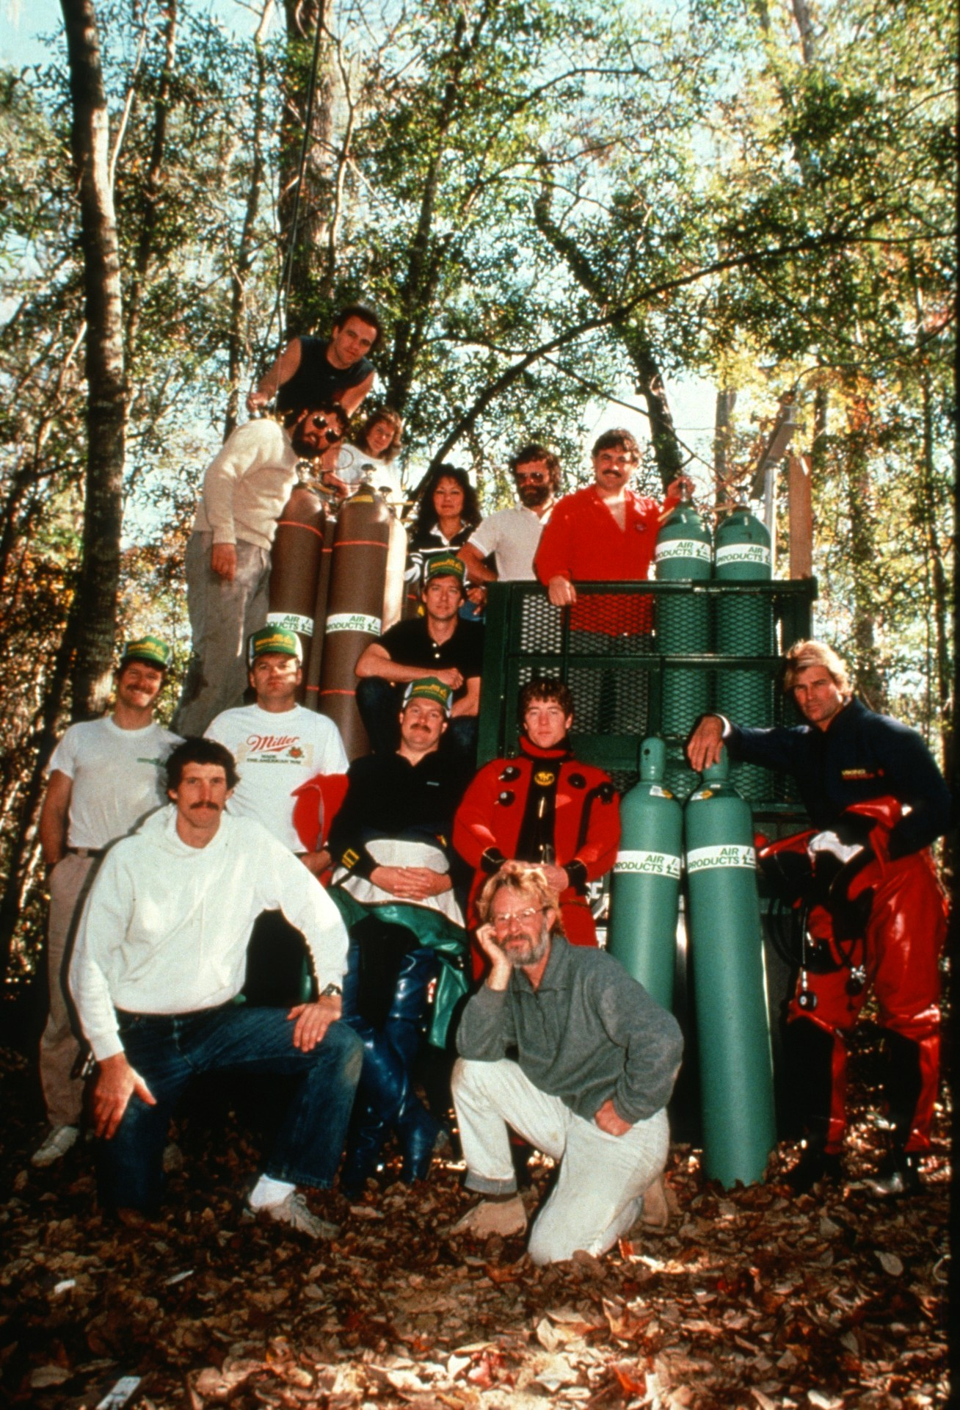
Notes:
Team photo at the Air Products gas depot: (l to r, rear): Tex Chalkley, Gavin Newman, Mandy Dickinson, Tara Tanaka, Leo Dickinson, Paul Heinerth, (l to r, middle): Sheck Exley, Paul Deloach, Wes Skiles, Rob Parker, Brad Pecel. (l to r, front): Bill Stone, Pete Scoones. (Bill Stone)

Slide 21
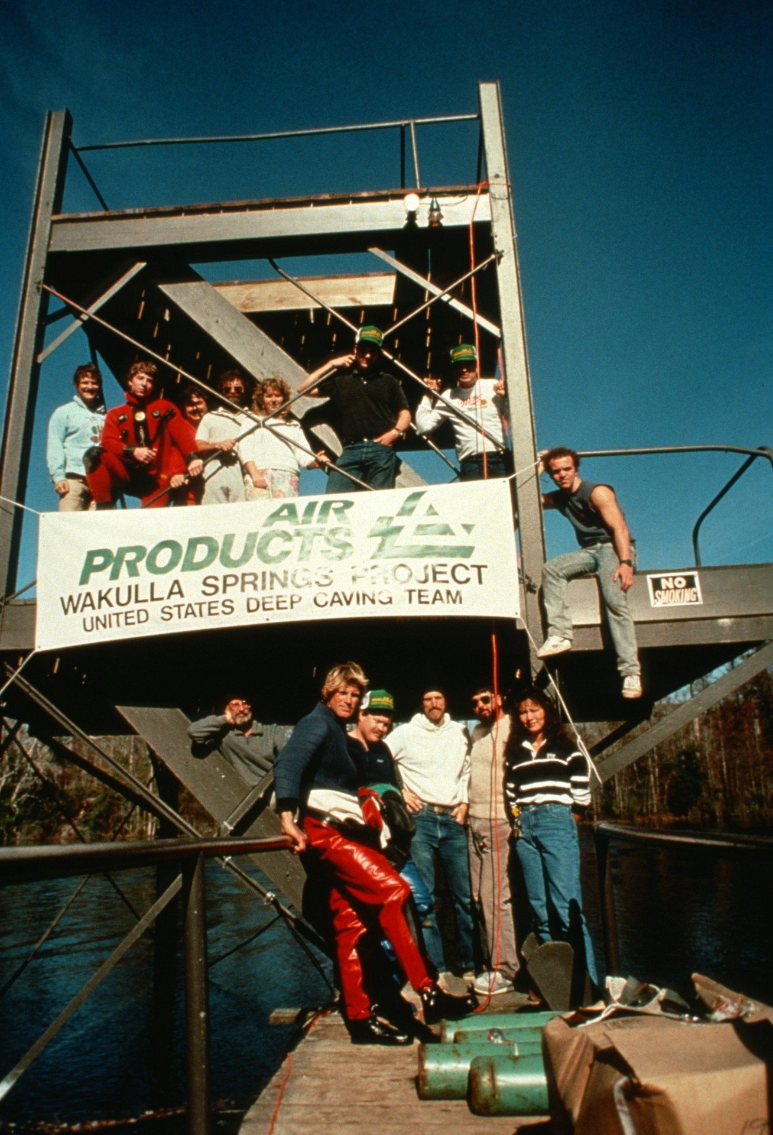
Notes:
Team photo at the diving tower: (l to r, top deck): Parker, Paul Heinerth, Leo Dickinson, Mandy Dickinson, DeLoach. (l to r, lower deck): Pete Scoones, Brad Pecel, Stone, Tex Chalkley, Tara Tanaka. (Bill Stone)

Slide 22
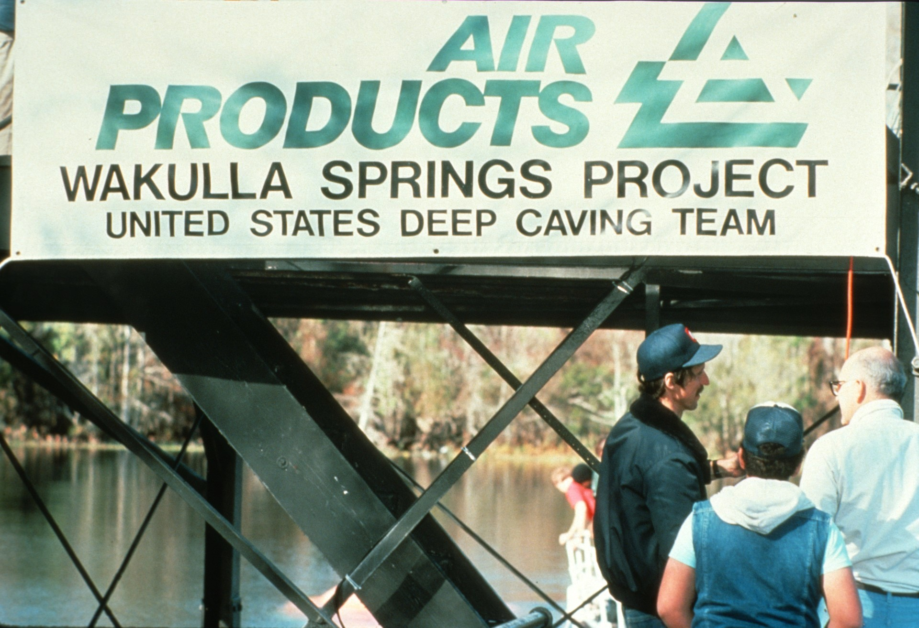
Notes:
Air Products logo at the dive tower. (Edward Sheffe)

Slide 23
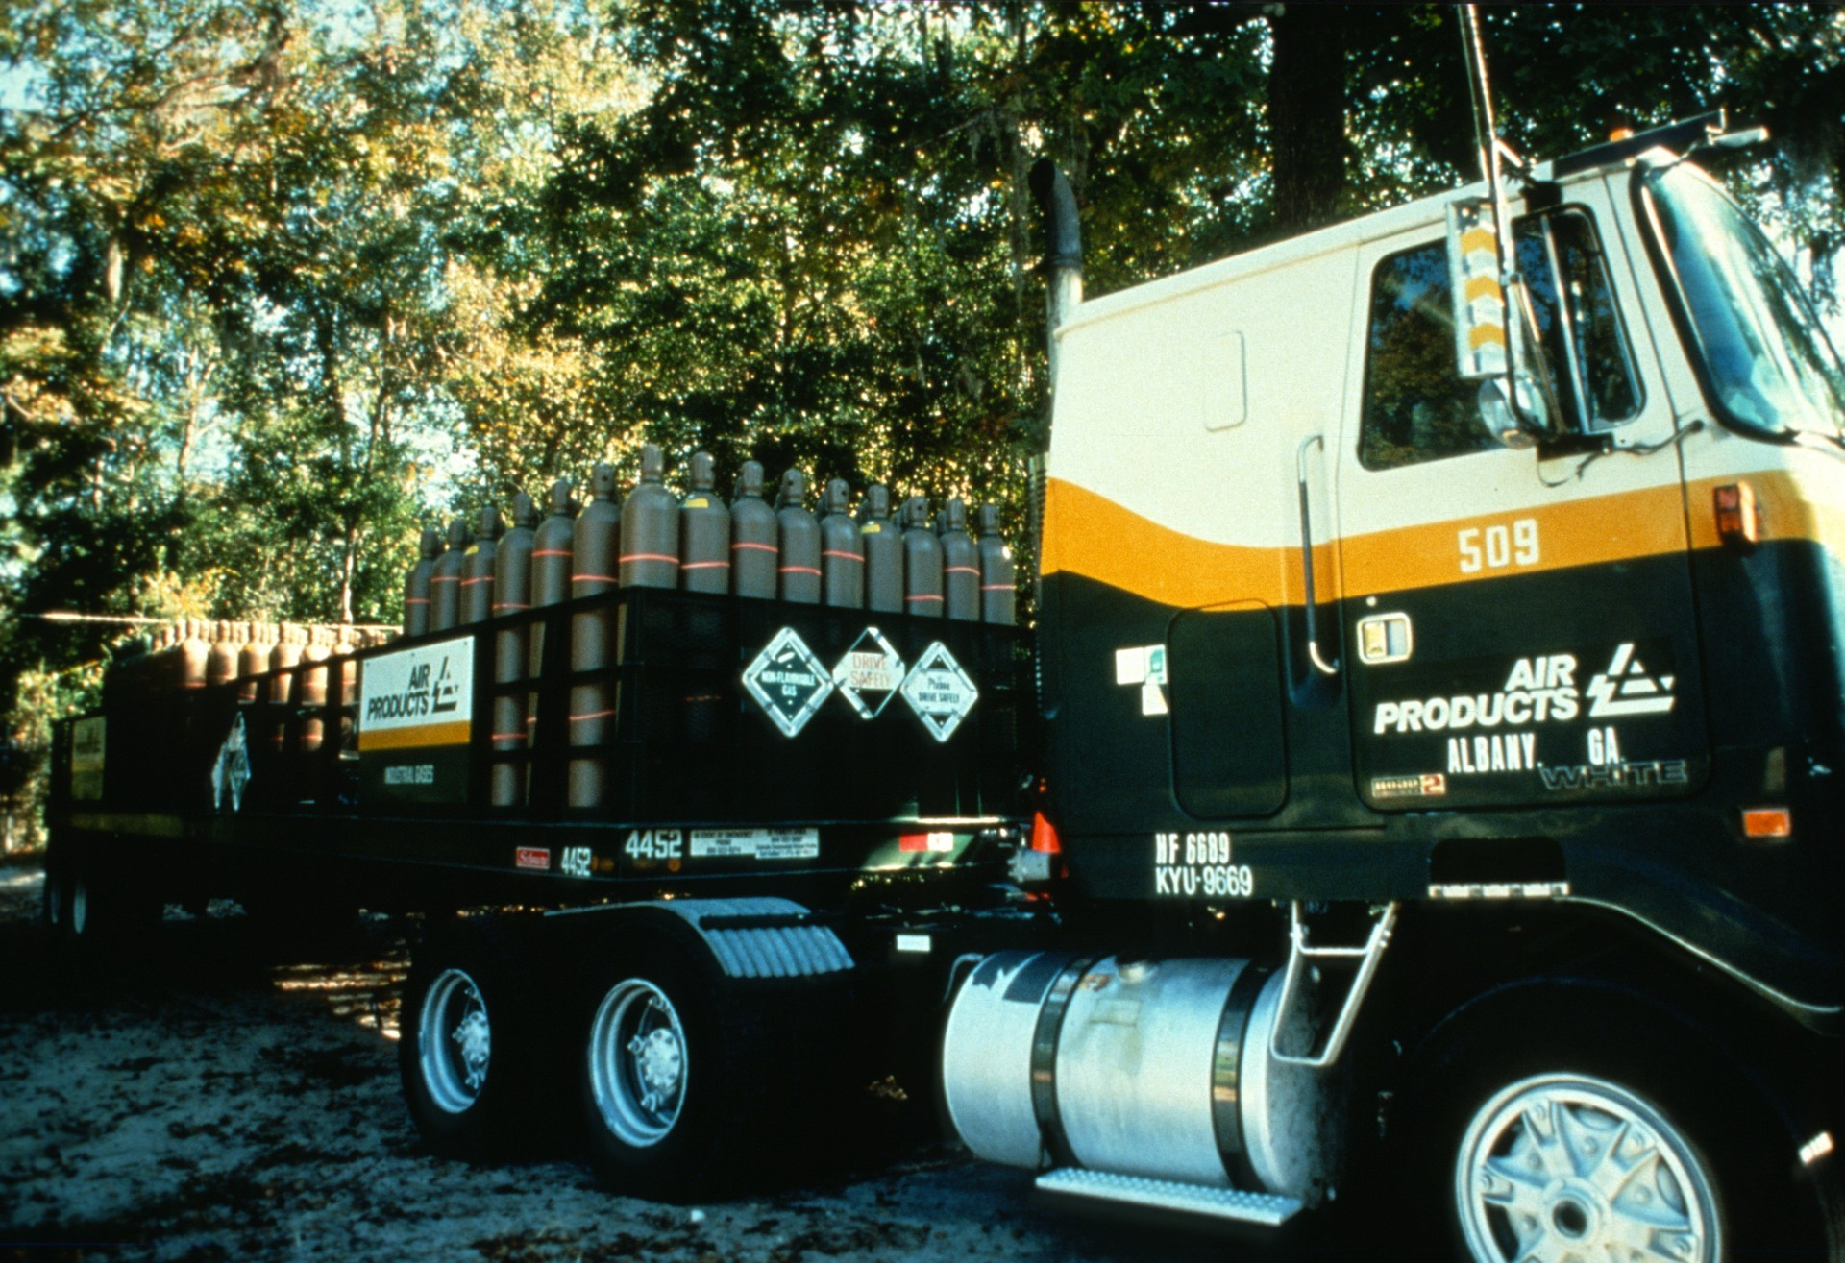
Notes:
Arrival of the first shipment of helium and oxygen from Air Products at Wakulla Springs. (Wes Skiles)

Slide 24
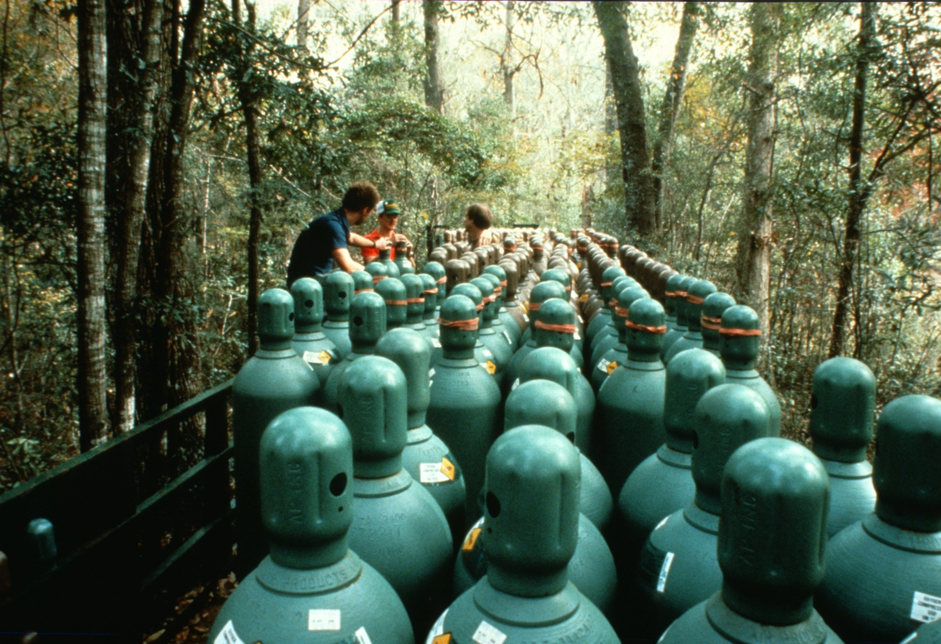
Notes:
Change-out time on the Air Products trailer: Gavin Newman, Clark Pitcairn, and Noel Sloan unload fresh oxygen. (Bill Stone)

Slide 25
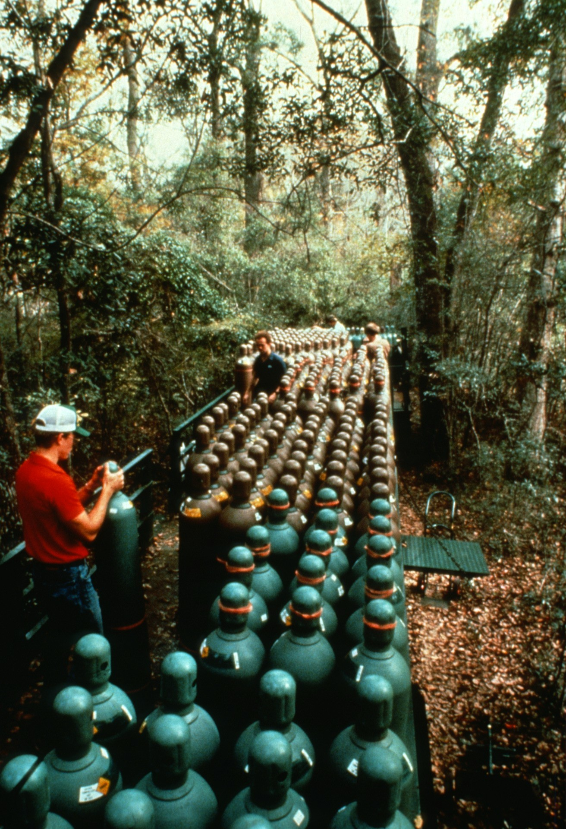
Notes:
During the 10-week expedition diving teams used 90,000 cubic feet of Helium-Oxygen and 30,000 cubic feet of pure oxygen donated by Air Products. This amounted to two complete semi-tractor trailers full of gas bottles. Team member Clark Pitcairn is shown here changing out spent cylinders. (Bill Stone)

Slide 26
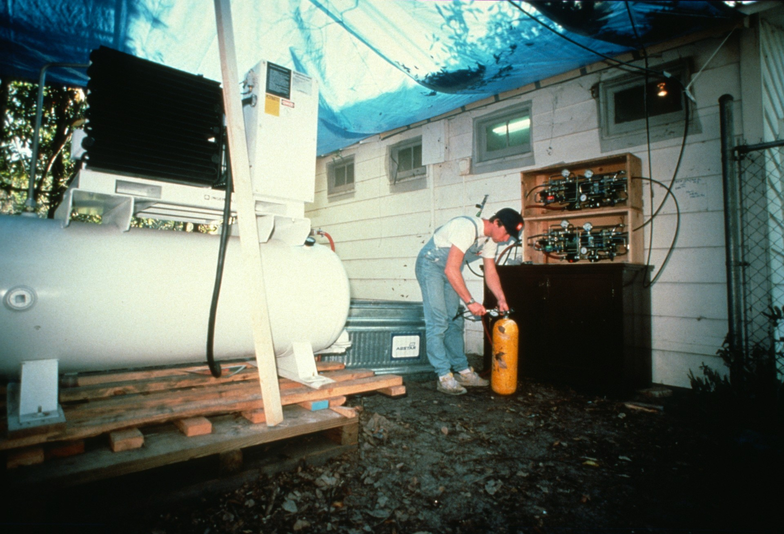
Notes:
Rob Parker tending to the mixed-gas charging station. Ingersoll-Rand 125cfm compressor at left provided the drive air for a bank of twin Haskel boosters used to transfer gas from the Air Products trailer to the diving cylinders. (Gavin Newman)

Slide 27
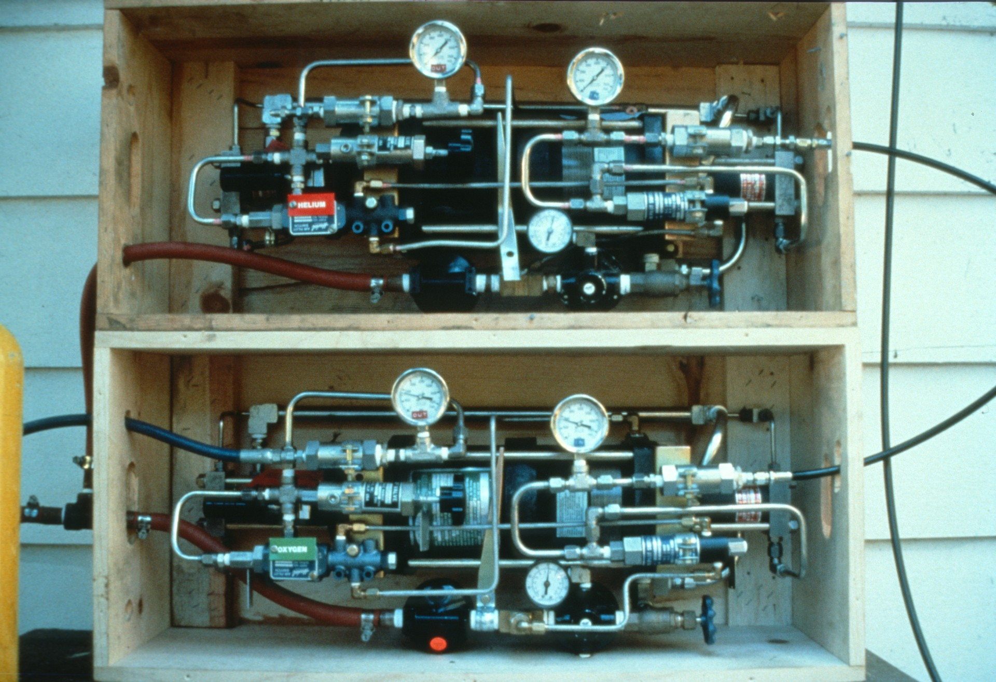
Notes:
Close-up of the Haskel boosters. Top one was used for heliox transfer; bottom for oxygen. With a fresh set of supply gas cylinders it took approximately 10 minutes to completely charge a set of twin 104 steel diving cylinders with heliox. (Angel Soto)

Slide 28
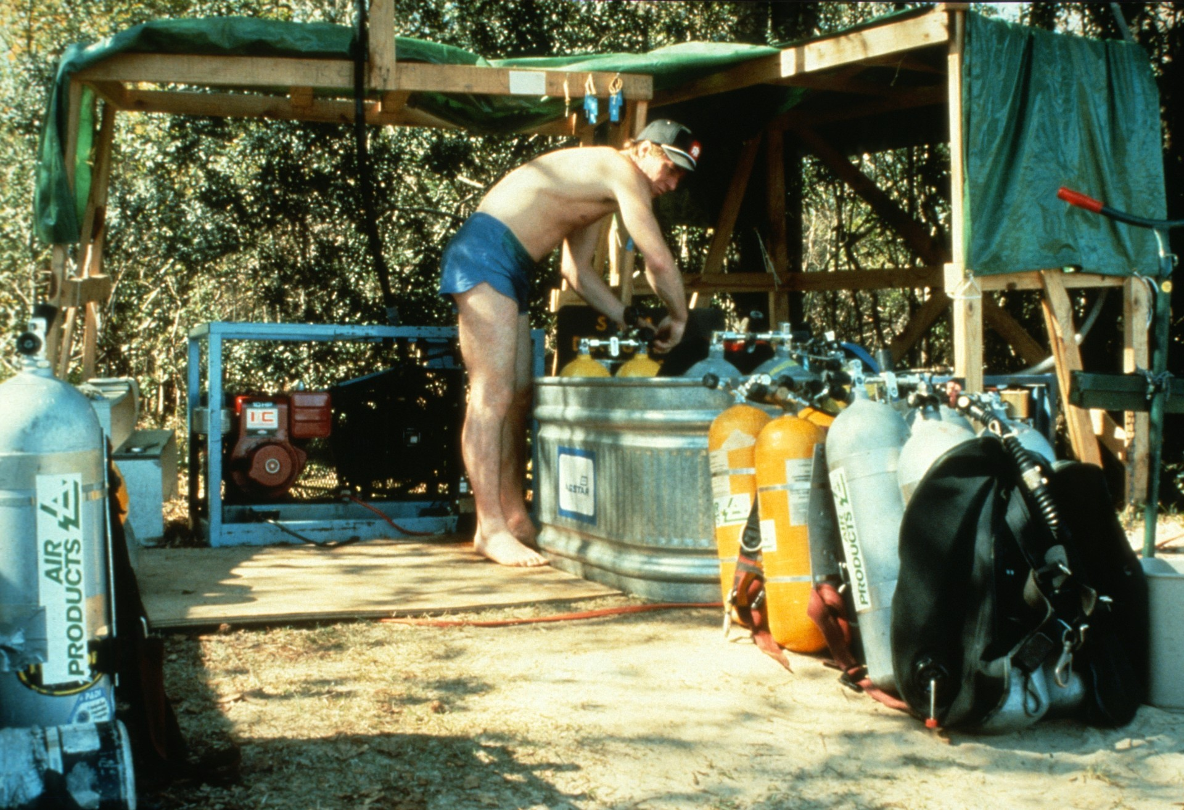
Notes:
Rob Parker manning the compressed air charging station near the diving tower. Two Mako 7cfm/5000psi compressors at this location were in use nearly 6 hours per day. (Angel Soto)

Slide 29
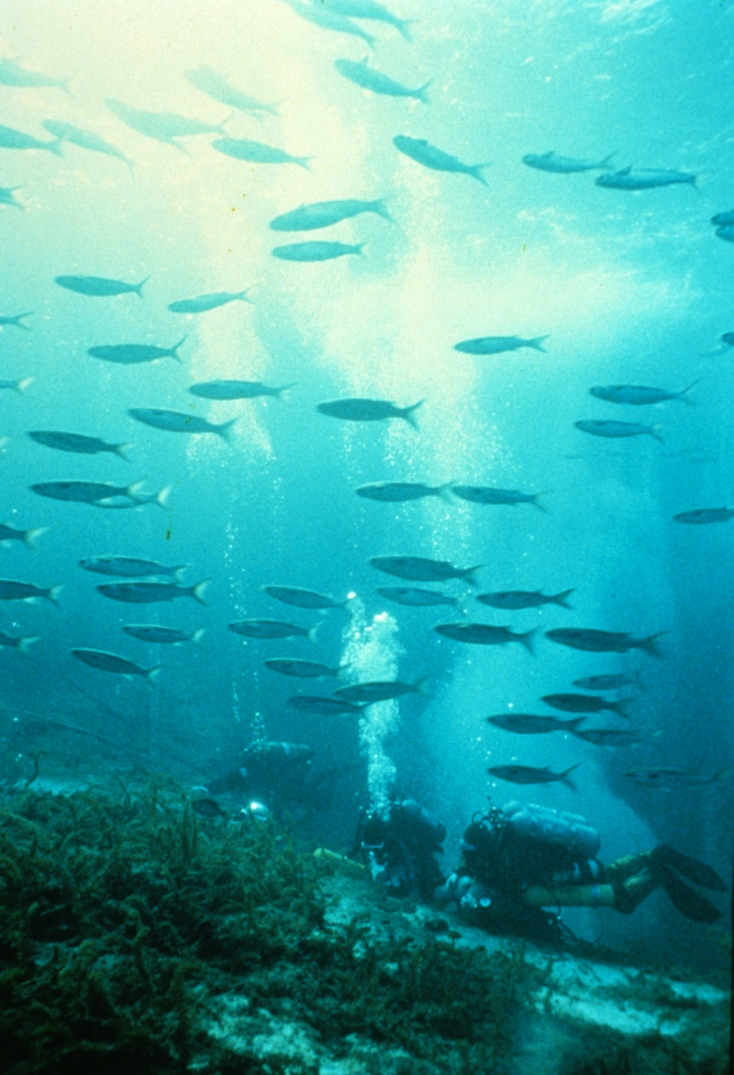
Notes:
A school of mullet passes an exploration diving team as they reach the 20-foot decompression stop in Wakulla Spring. (Pete Scoones)

Slide 30
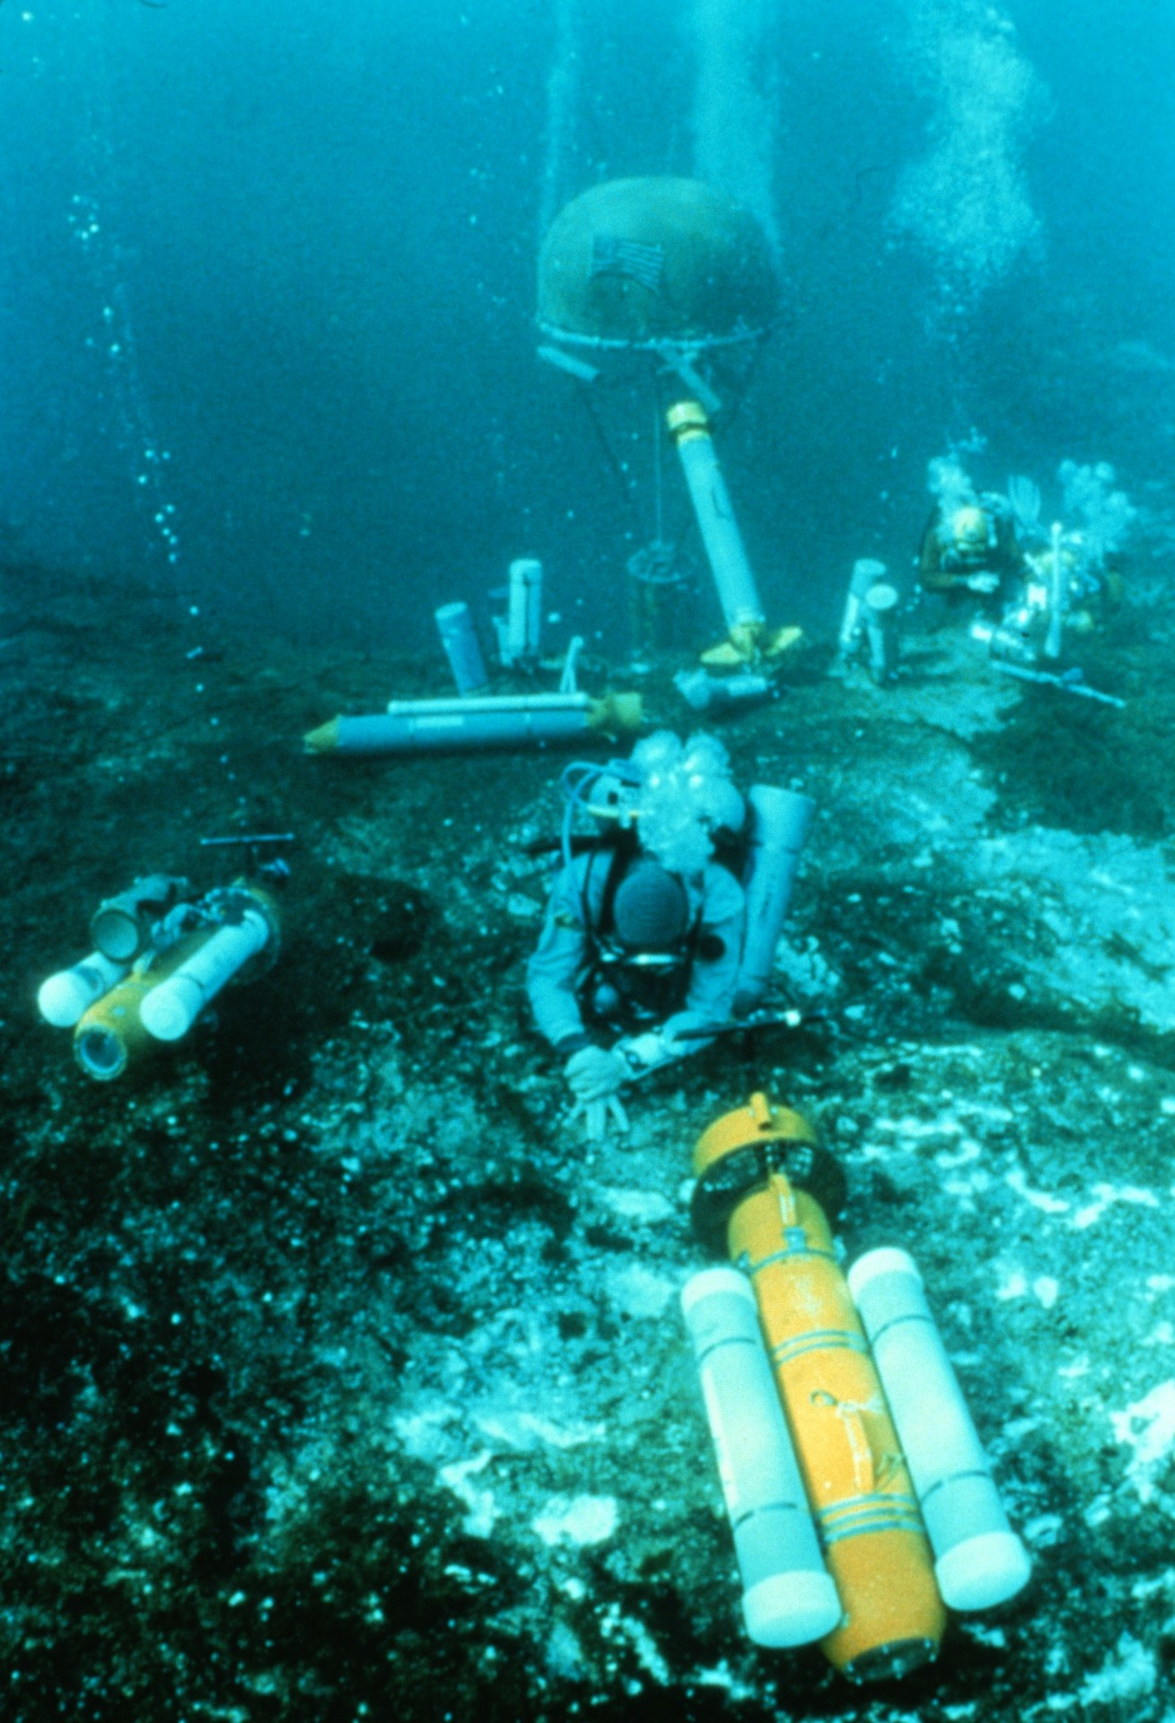
Notes:
Long, cold decompression follows a deep dive in Wakulla Spring. Diver propulsion vehicles and oxygen bottles lay littered about Wakulla Basin. In the distance our “underwater habitat” is not yet operational. (Pete Scoones)

Slide 31
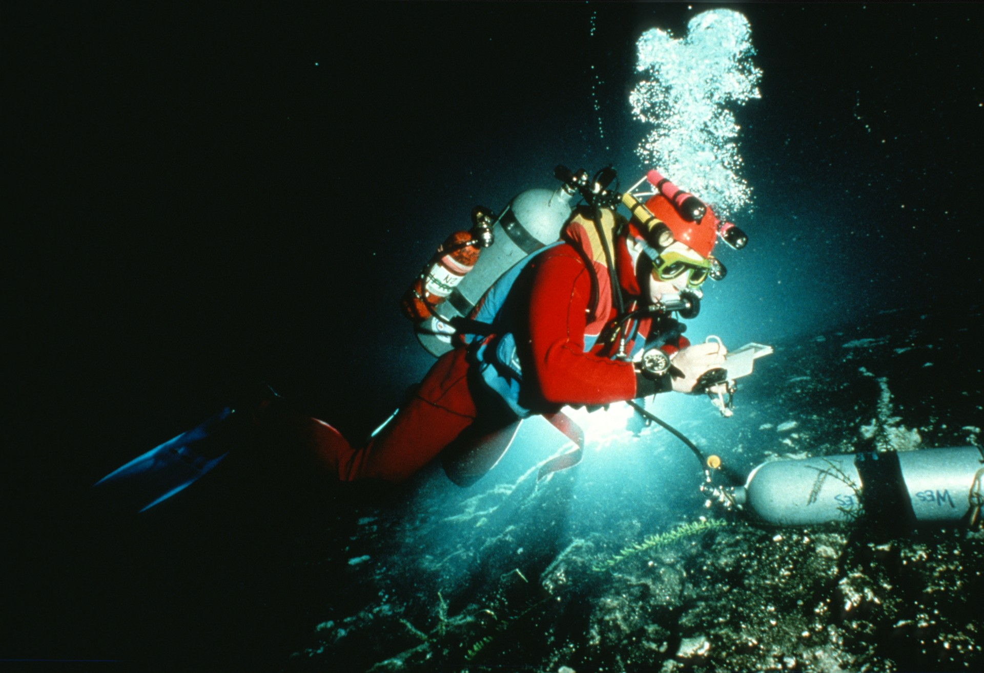
Notes:
Rob Parker rechecks final decompression time at the 10-foot decompression stop in Wakulla Spring. Exploration dives typically had mid-afternoon starts (due to the extensive gas charging requirements) with decompression extending well into night. (Gavin Newman)

Slide 32
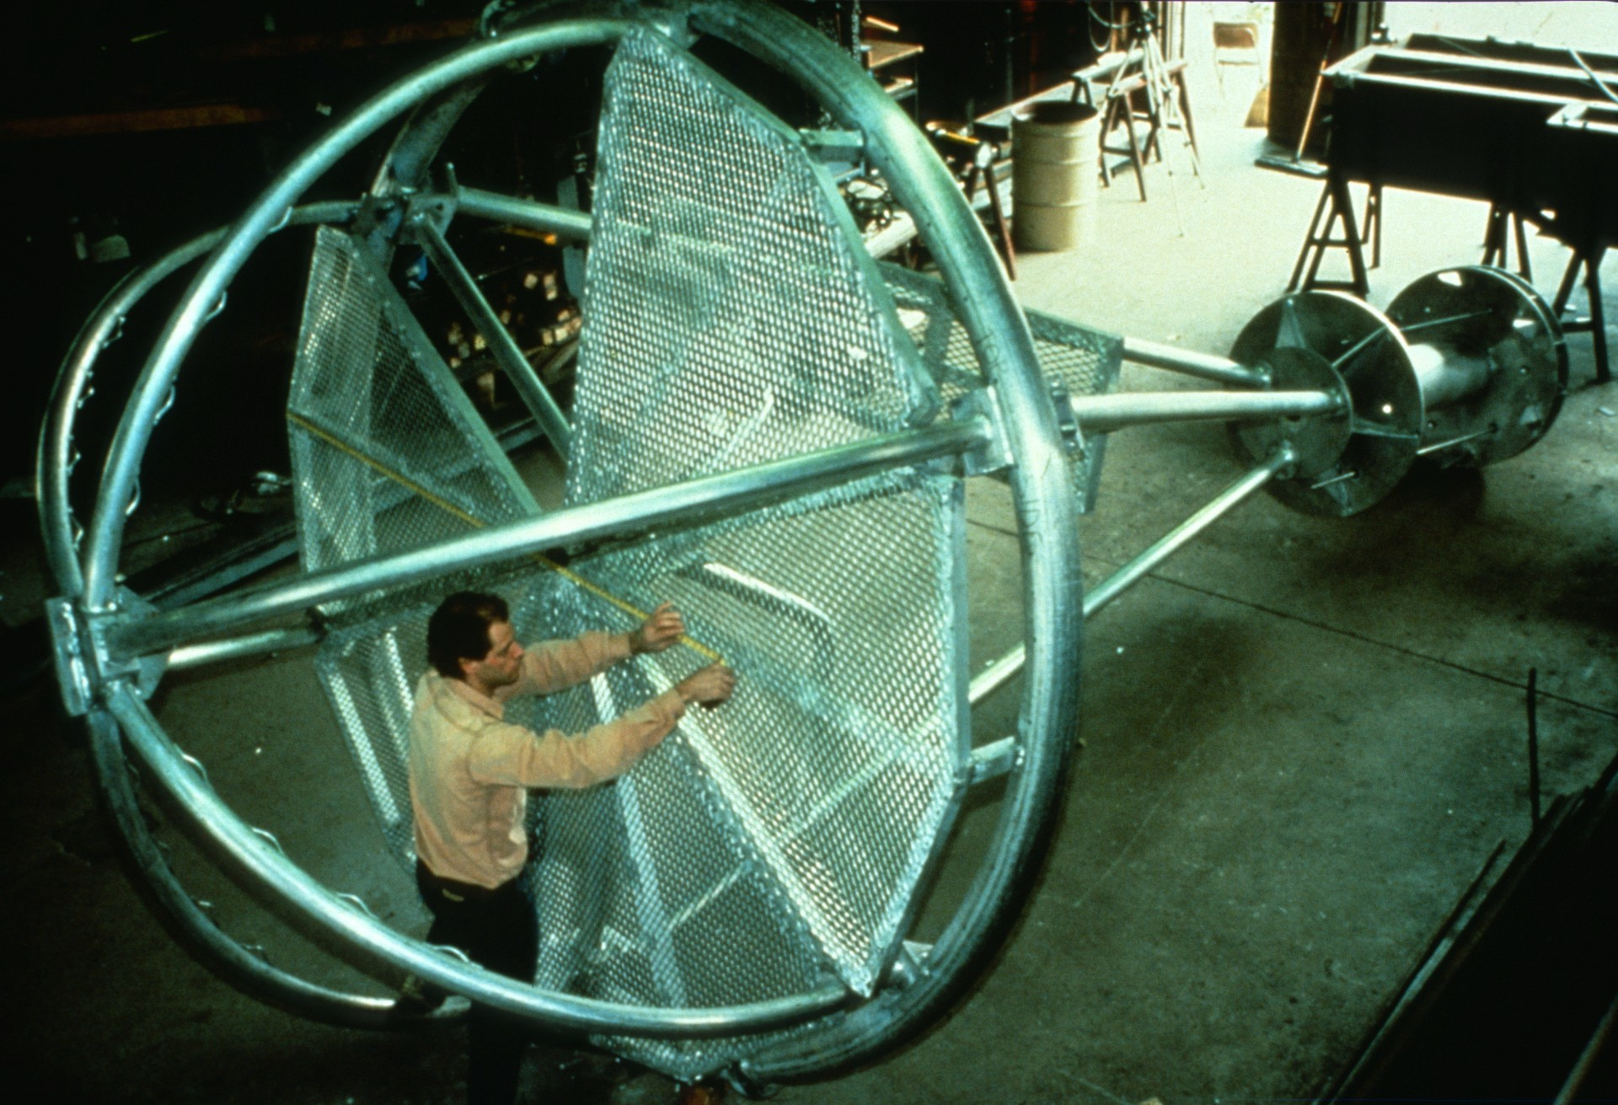
Notes:
To overcome hypothermia during a 14-hour diving mission (a common dive time during the expedition) we designed the world's first portable, variable depth underwater habitat. Here the support frame for the living quarters is being fabricated (Bill Stone)

Slide 33
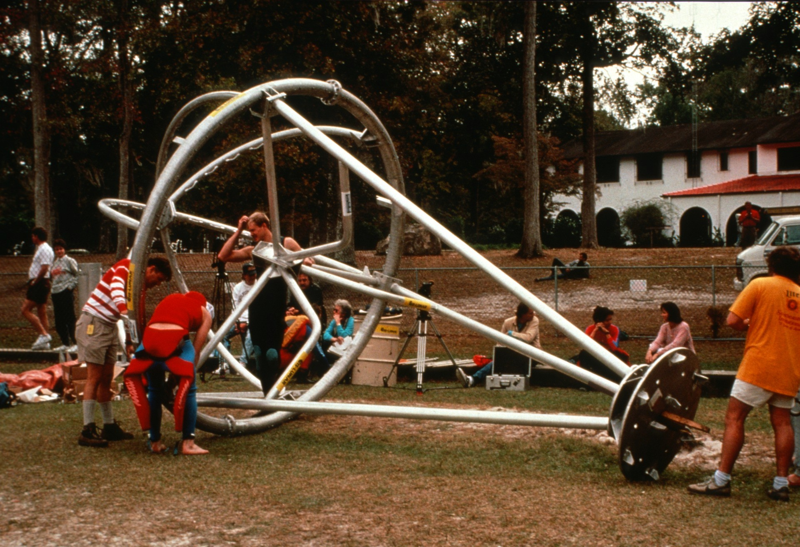
Notes:
Final surface assembly of the habitat frame takes place in front of Wakulla Lodge. (Bill Stone)

Slide 34
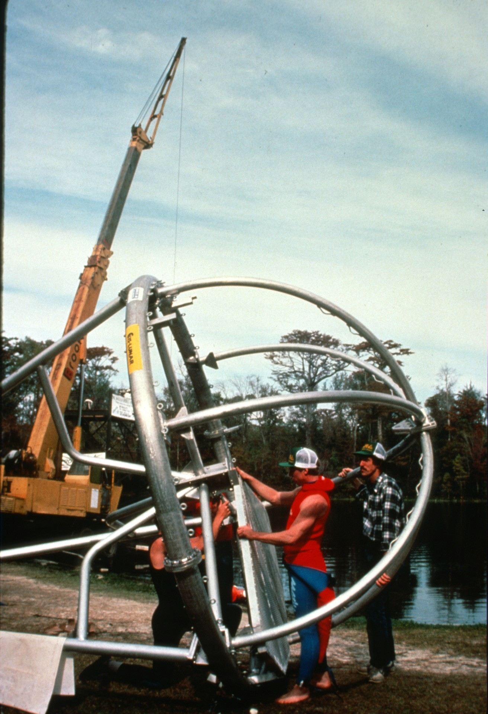
Notes:
Parker and Stone perform a final fit check of the living quarters deck prior to hoisting the structure with Bernard Brook's crane (Leo Dickinson)

Slide 35
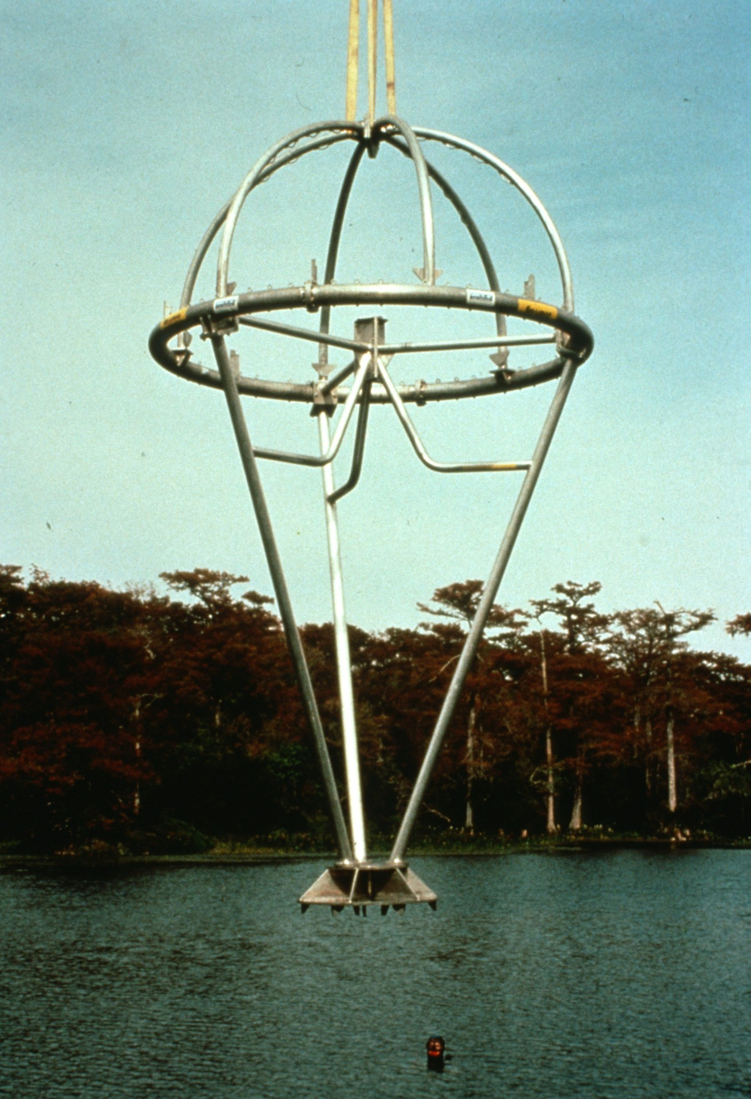
Notes:
The habitat frame is lowered into Wakulla Springs. (Bill Stone)

Slide 36
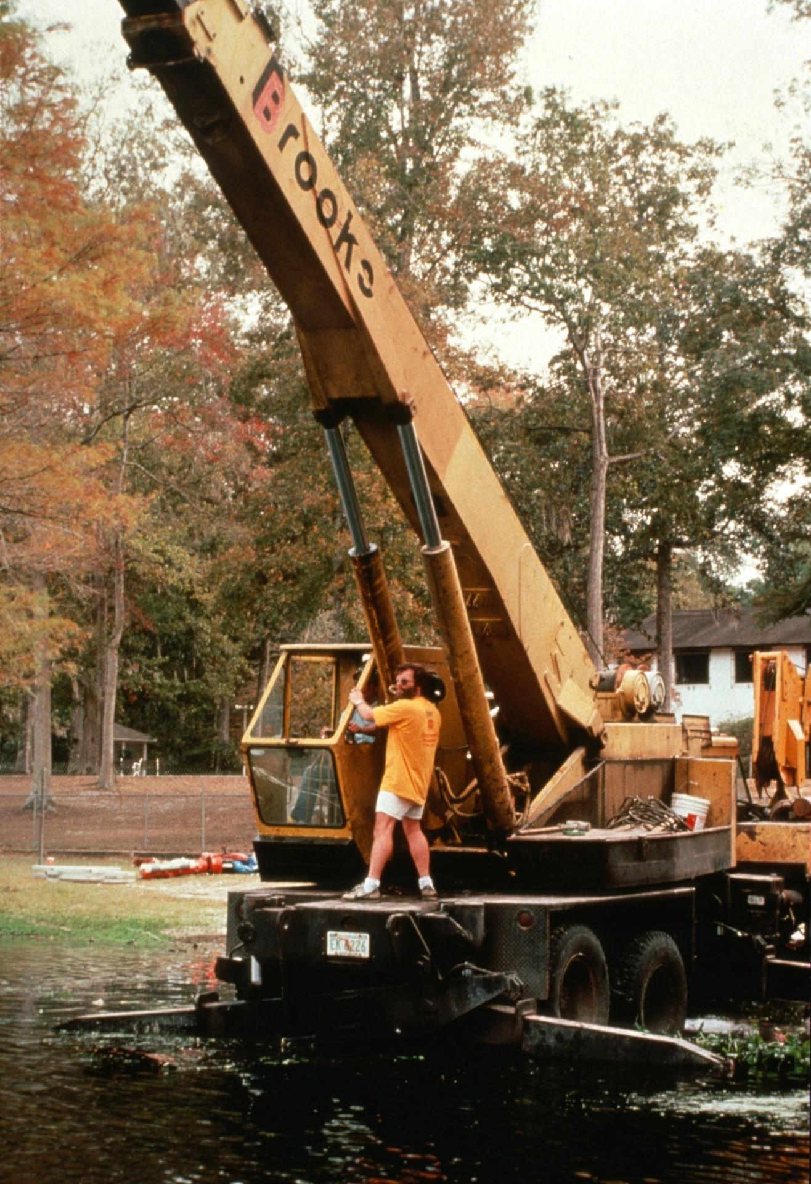
Notes:
Leo Dickinson films the crane operator as the habitat is maneuvered out into Wakulla basin. (Bill Stone)

Slide 37
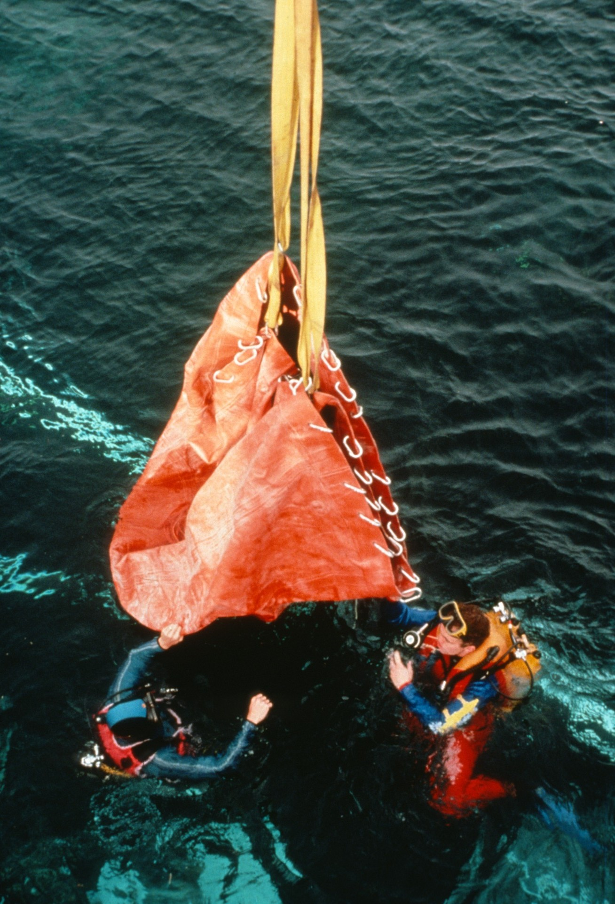
Notes:
The habitat shell is lowered into the water where support divers will transport it to the underwater construction site. Rather than use a heavy metal dome, novel use was made of high strength flexible composites to form a lightweight pressurizable hemisphere which could be carried by two individuals. (Bill Stone)

Slide 38
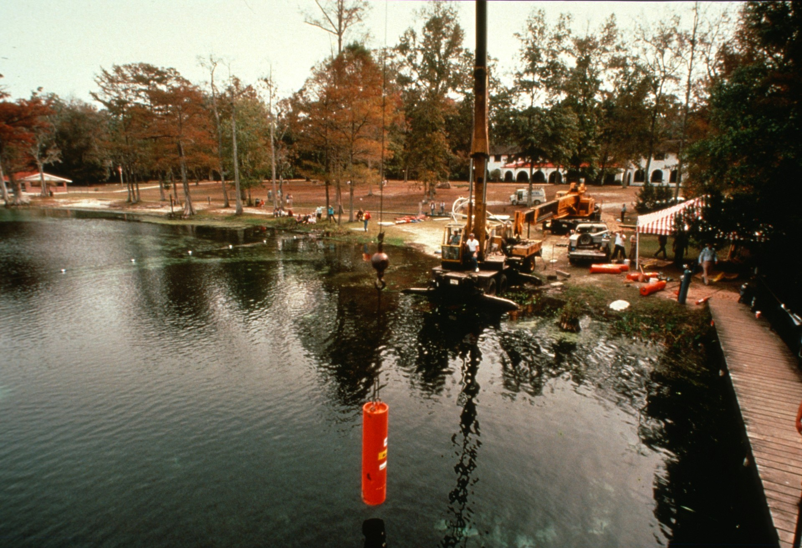
Notes:
The habitat was ballasted with 15,000 pounds of lead. This was conveniently handled by means of six steel-cased cylinders, each weighing 2, 500 pounds. Three additional cylinders formed an anchor cluster at the -120 foot level of the spring. (Bill Stone)

Slide 39
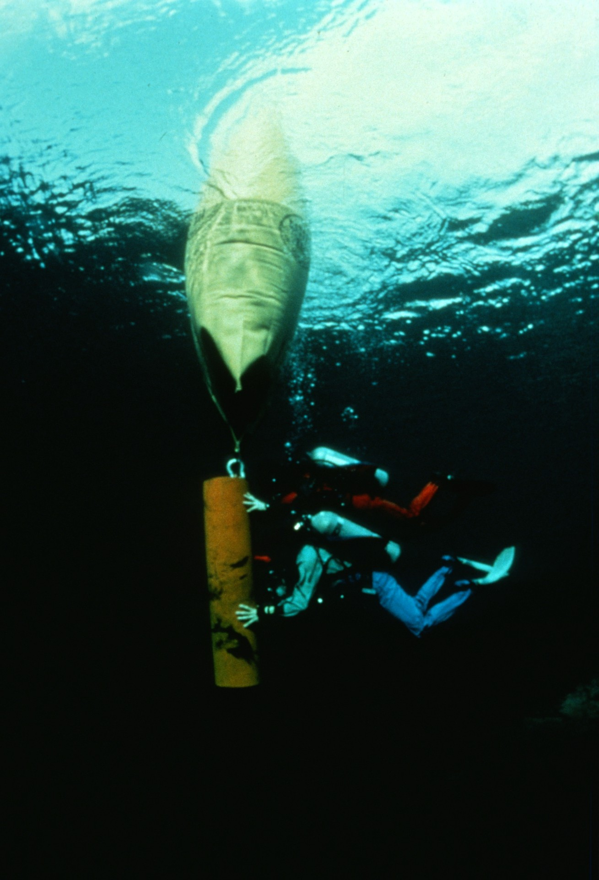
Notes:
Using 2-ton industrial lift bags a team of divers maneuvers one of 9 lead ballast weights into position for underwater construction of the habitat. (Leo Dickinson)

Slide 40
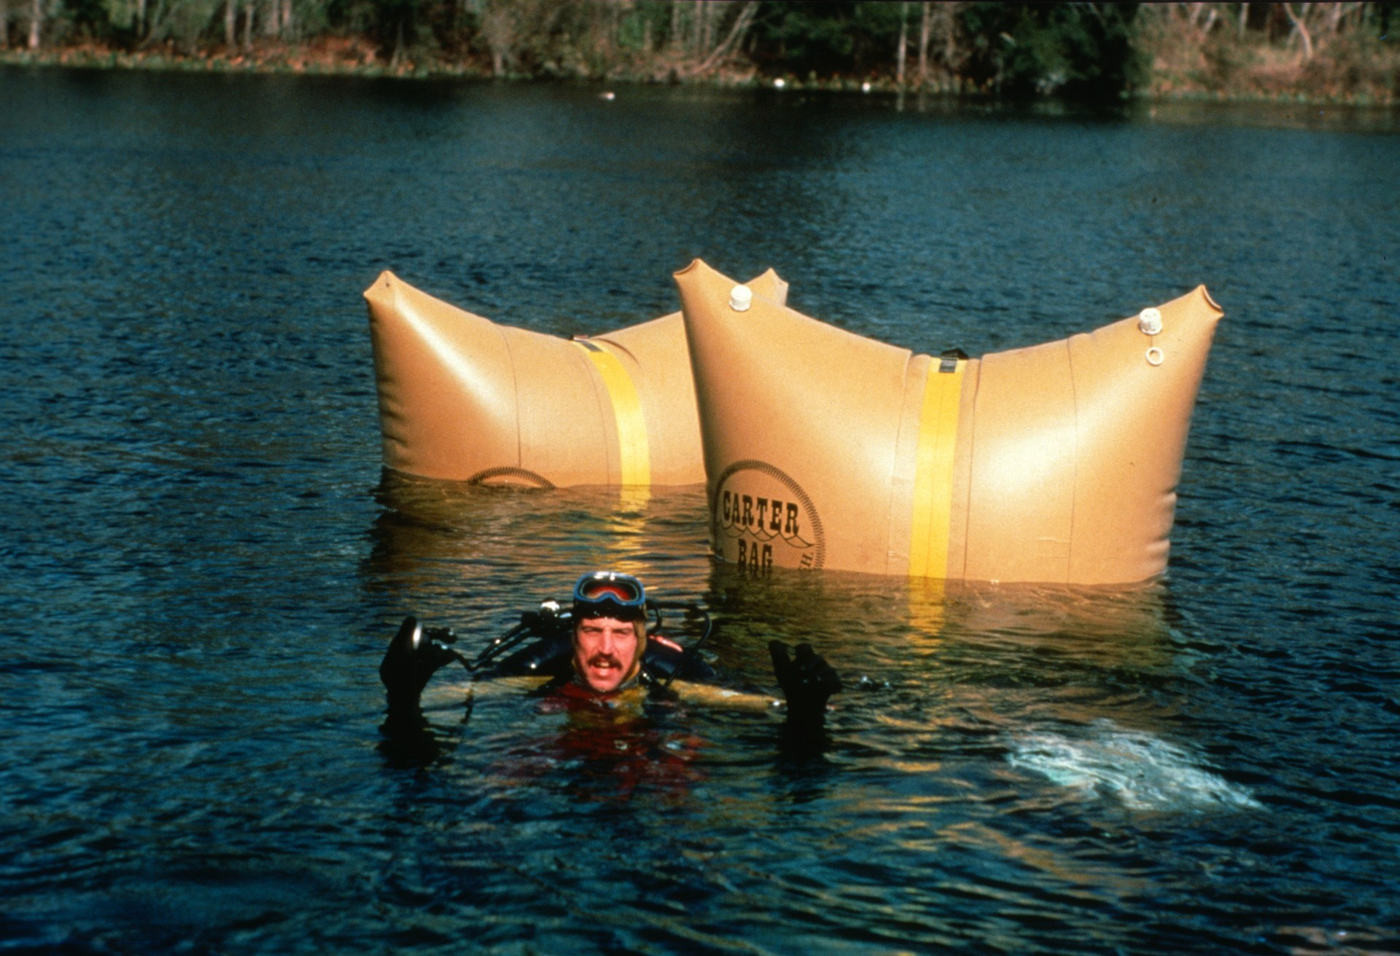
Notes:
Bill Stone calls back a status report as the habitat frame is transported to the underwater assembly site by means of two 2-ton lift bags. (Edward Sheffe)

Slide 41
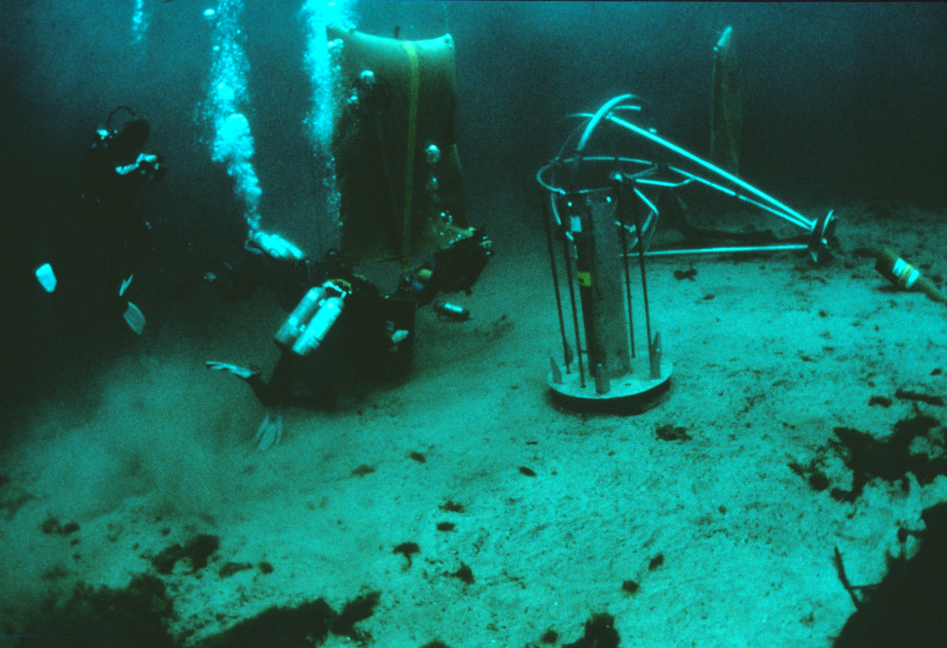
Notes:
Underwater construction site: the habitat takes form at -40 feet in Wakulla Basin. Divers are shown here assembling the deep-level anchor. To their right is the main habitat ballast carrier which will hold the six lead-filled cylinders. (Leo Dickinson)

Slide 42
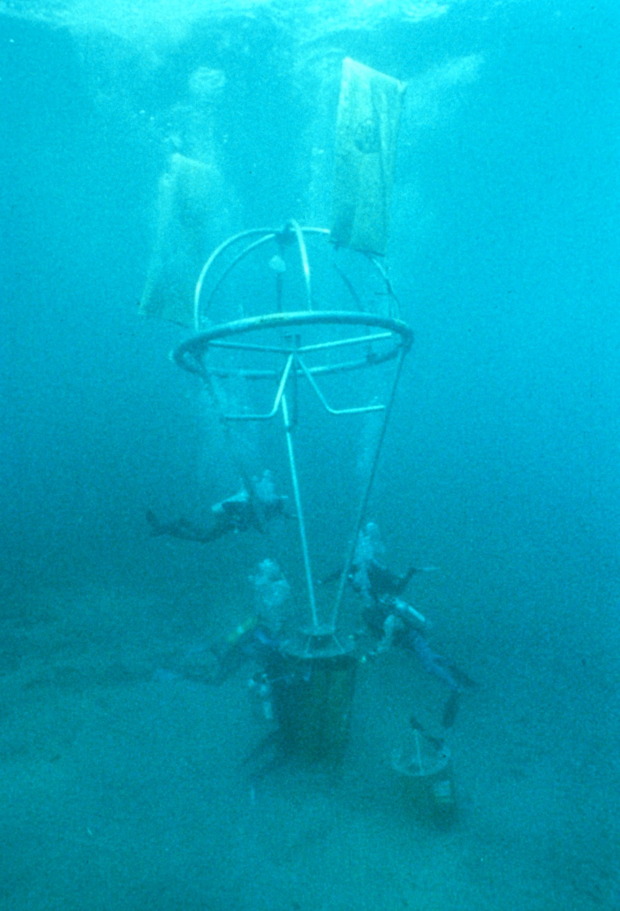
Notes:
Using two lift bags for balance, the support frame is lowered on top of the ballast carrier pallet. The connection is achieved by means of 6 1-inch diameter stainless rods. (Bill Stone)

Slide 43
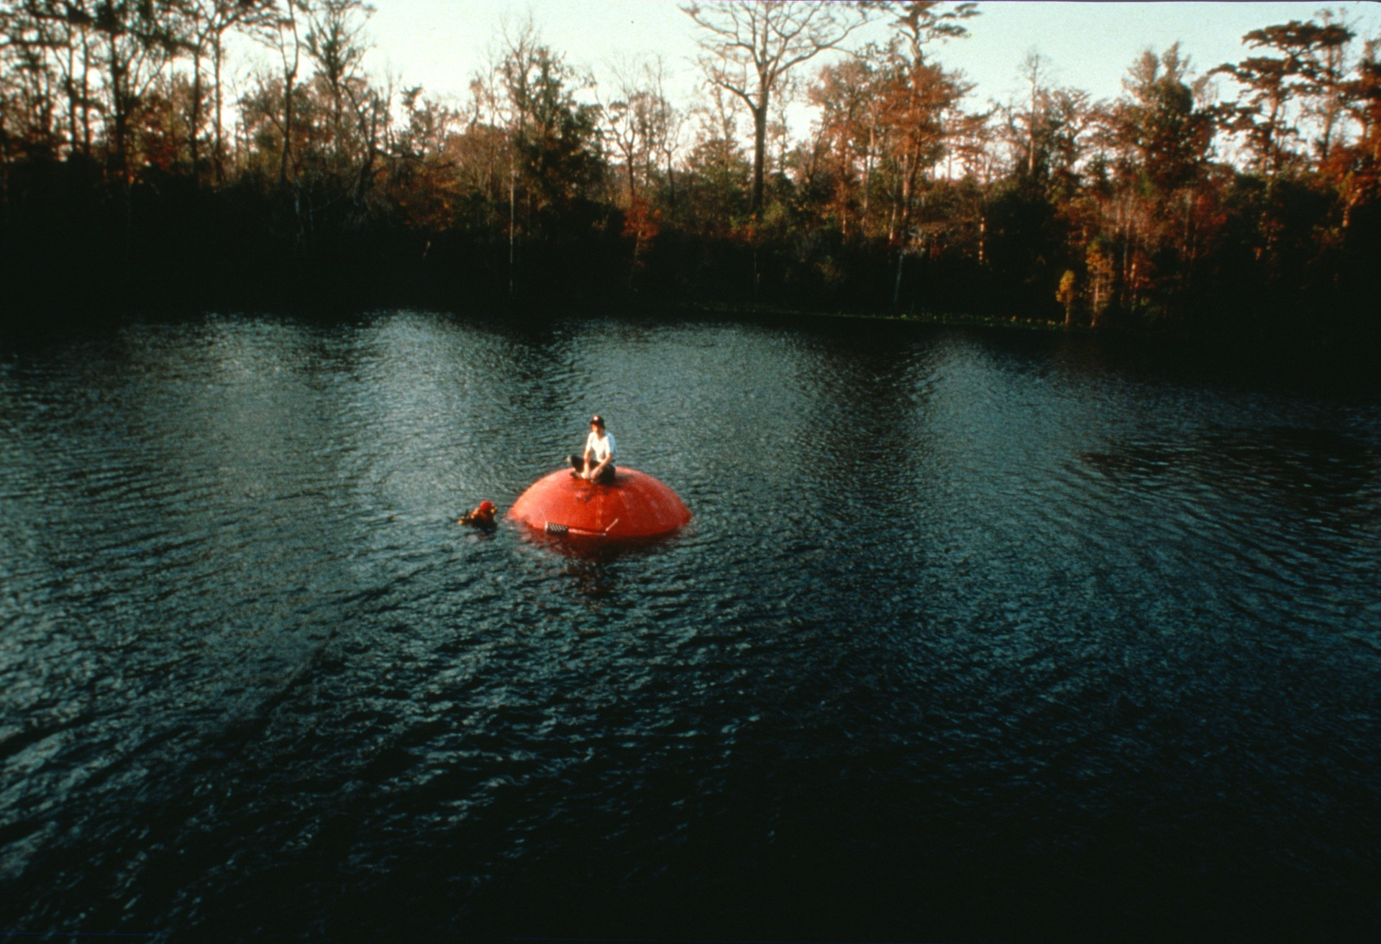
Notes:
Sitting atop the pneumatic shell, Stone lectures on the mechanics of the habitat for the Channel 4 documentary film. (Noel Sloan)

Slide 44
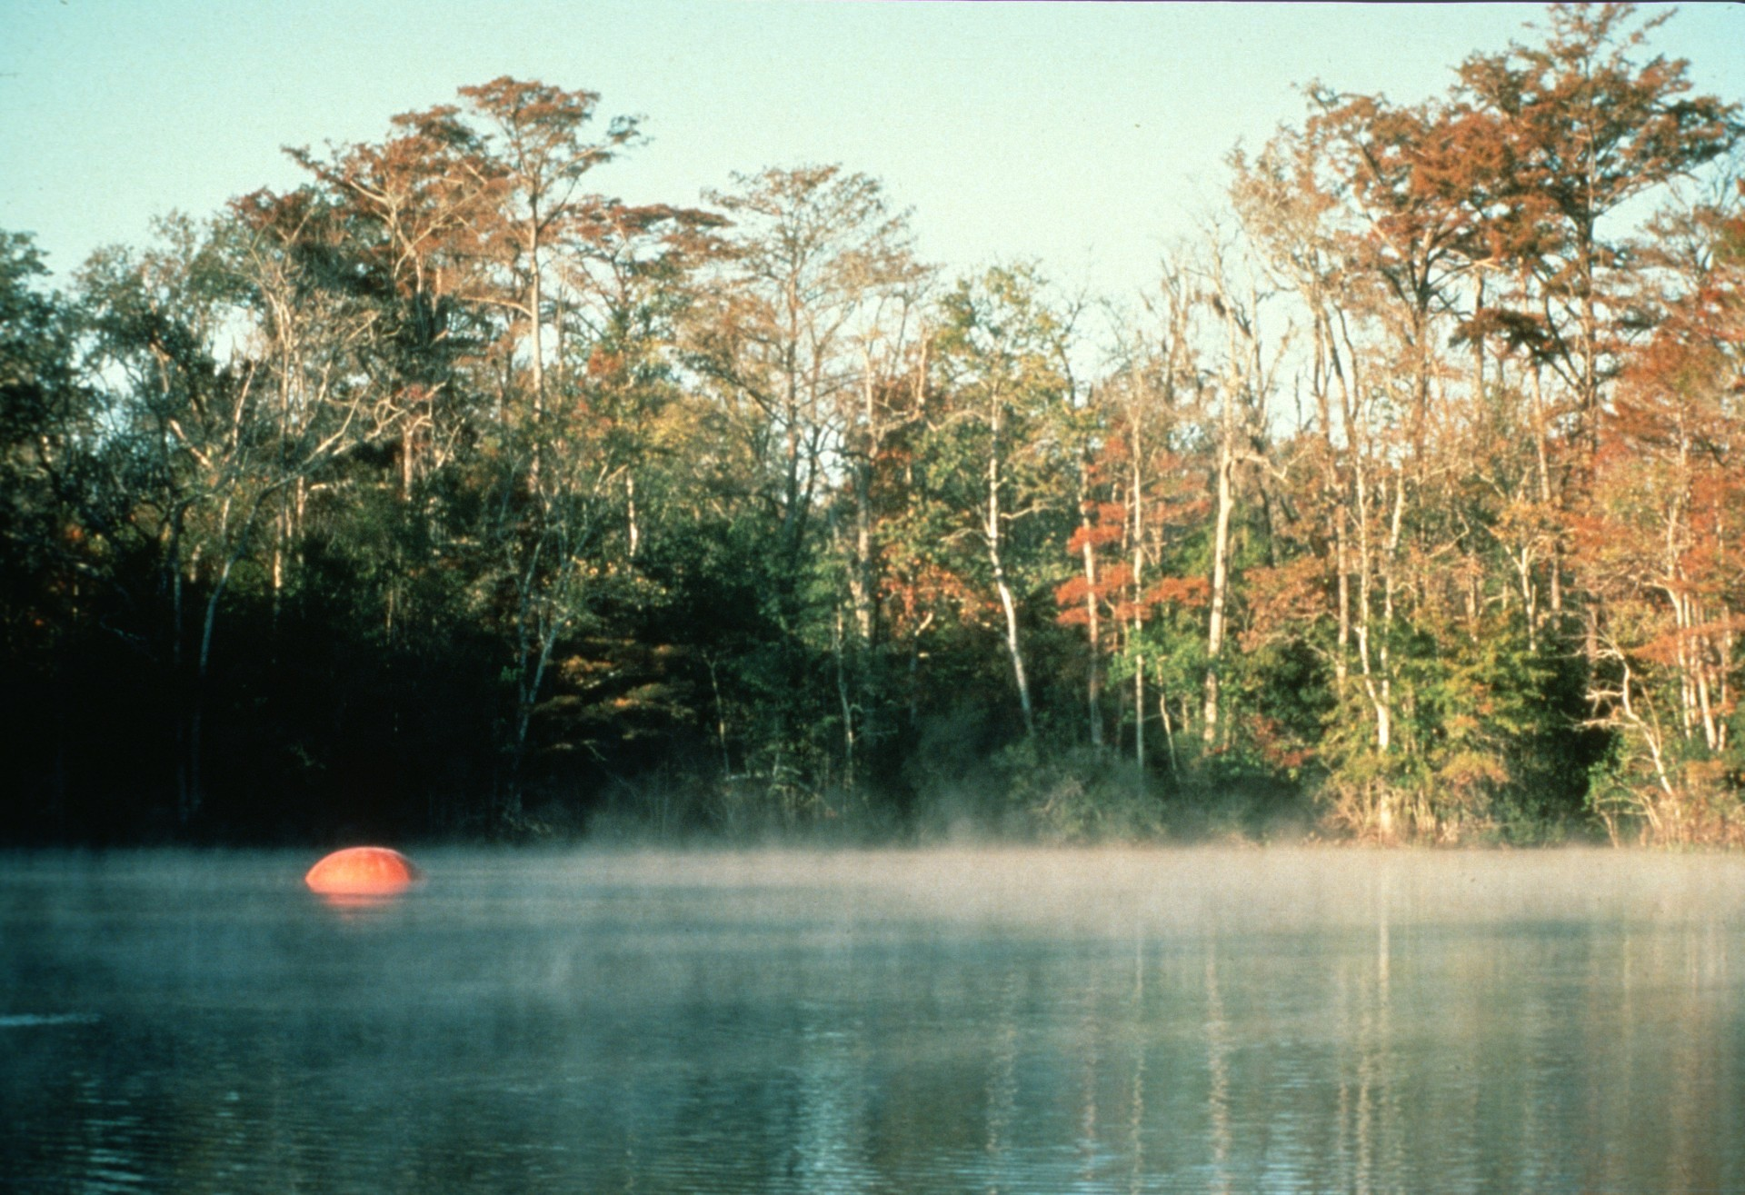
Notes:
Mysterious orange beach ball floats on Wakulla basin at dawn: without the onboard hoist to pull it underwater, the habitat floats some 2 feet out of the water. (Gavin Newman)

Slide 45
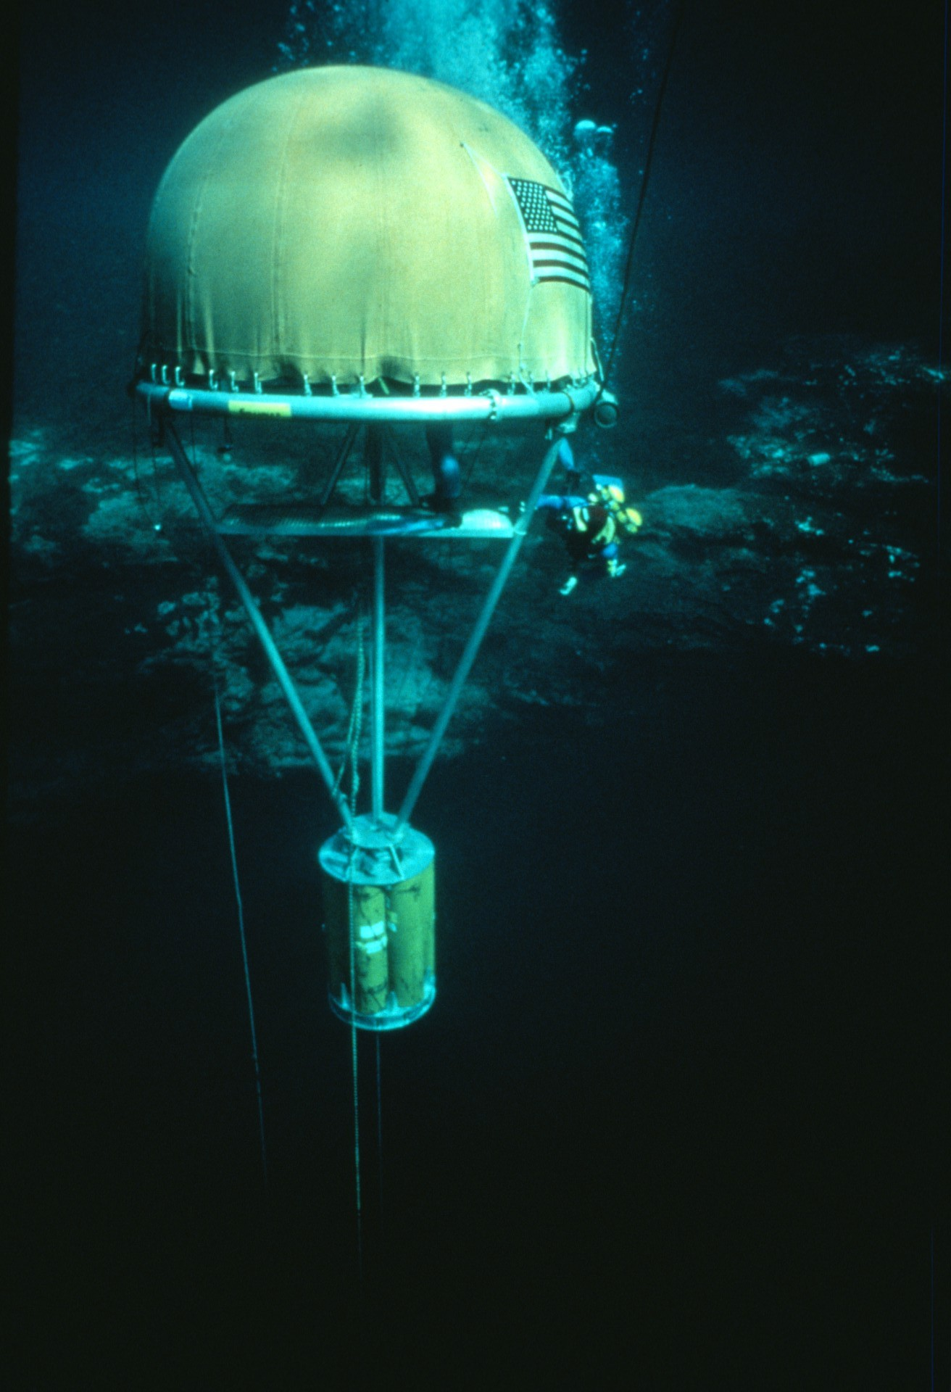
Notes:
First successful test dive of the habitat. Onboard hoist was used to pull the habitat down to lower depths. Maximum depth achievable was 70 feet due to the topography of Wakulla basin. In addition to the primary hoist, a high strength aircraft cable provided a backup in order to prevent an uncontrolled ascent in the unlikely event of a failure in the hoist chain. (Carl Ganter/National Geographic)

Slide 46
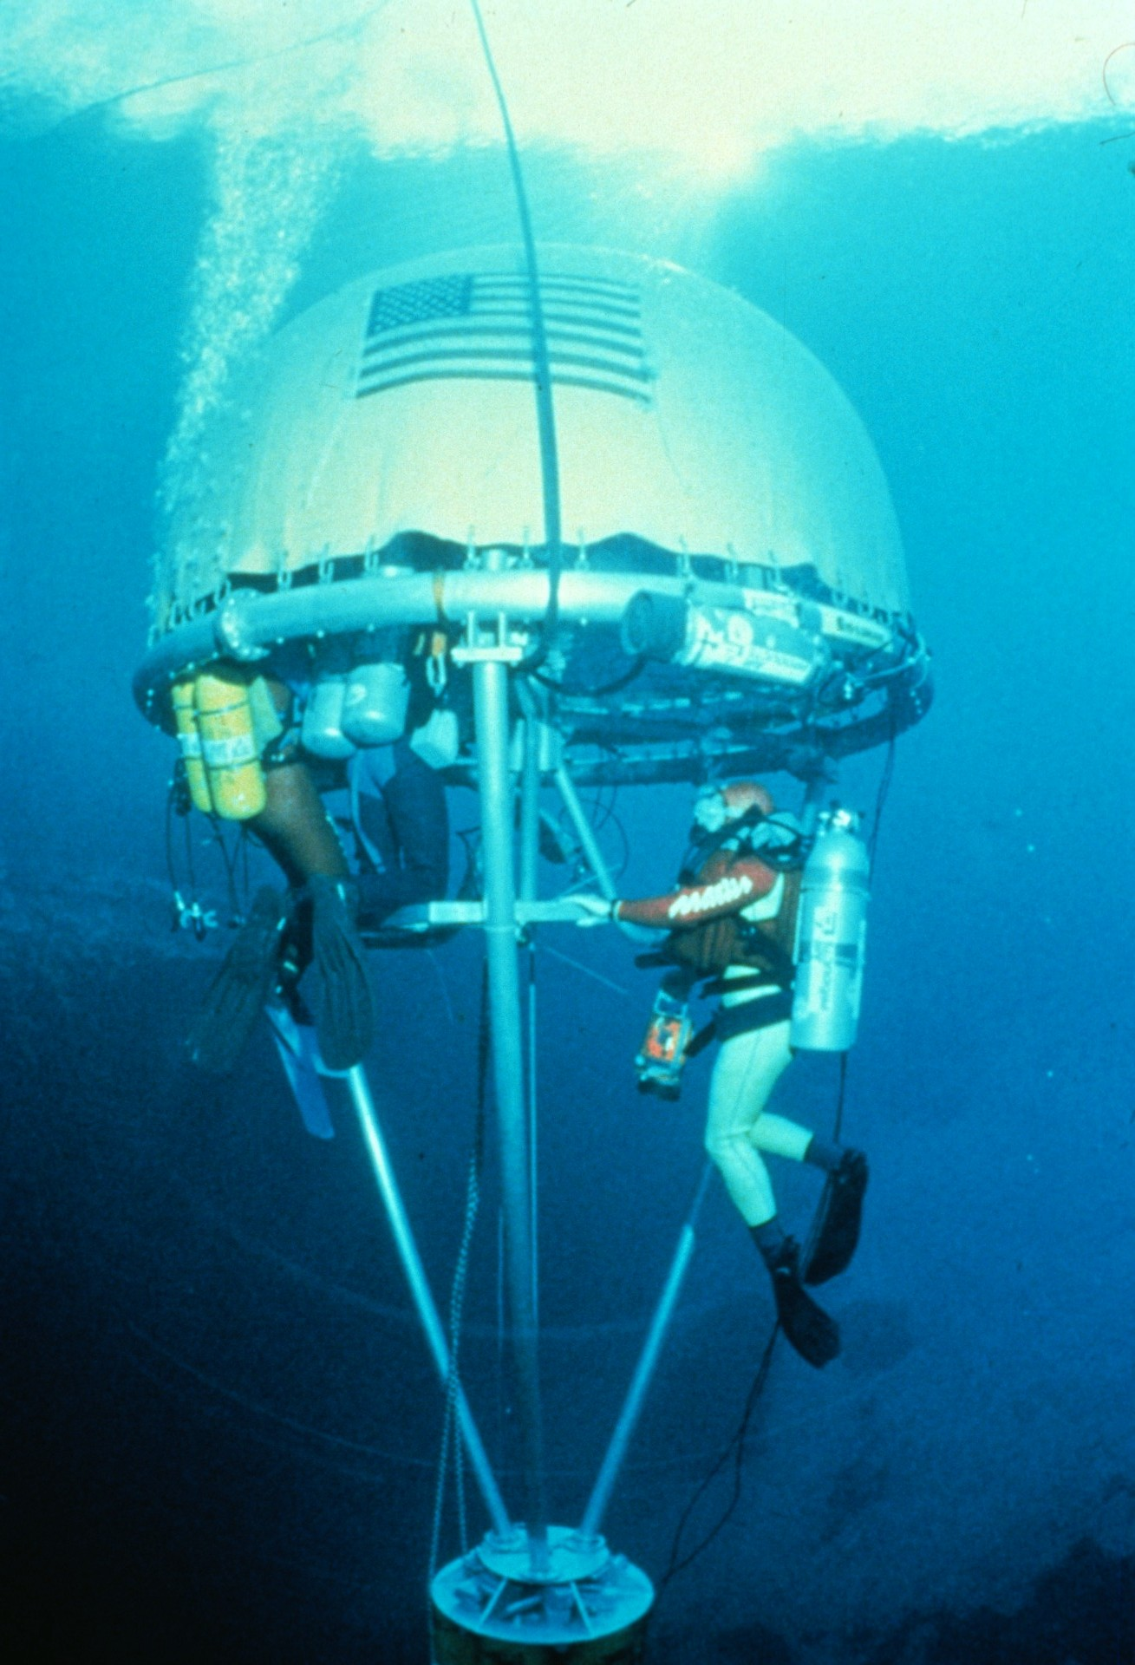
Notes:
Divers check out the assembled habitat during its first test. (Pete Scoones)

Slide 47
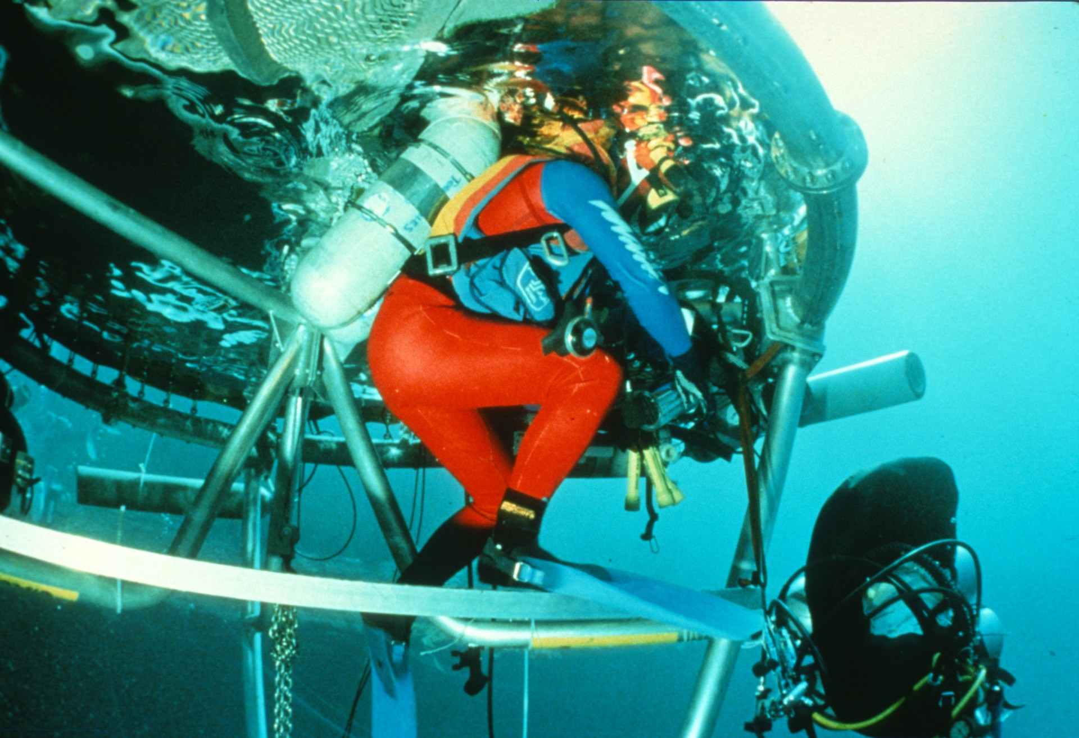
Notes:
Entry into the habitat was through a 60-degree pie-shaped opening. A lower deck permitted a fully kitted diver to enter easily. (Pete Scoones)

Slide 48
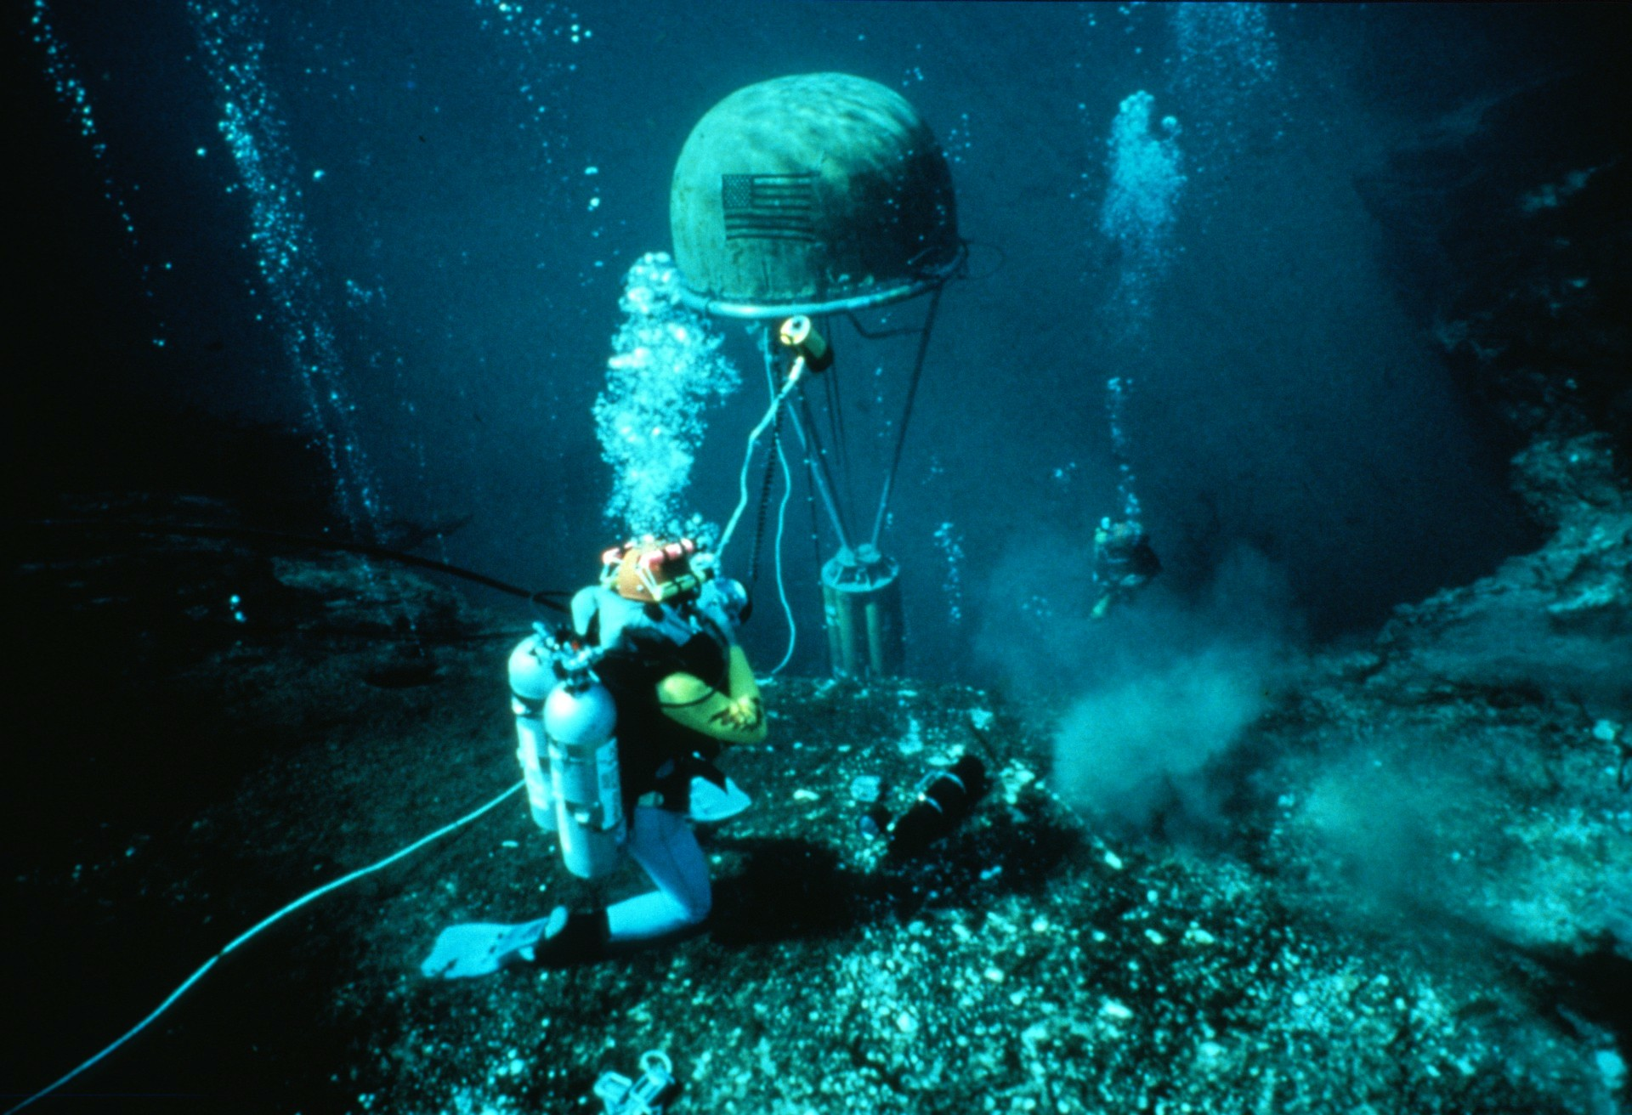
Notes:
Like a missile rising from a silo, the habitat ascends through the crescent shaped entrance of Wakulla Spring at the -30 foot level. (Pete Scoones)

Slide 49
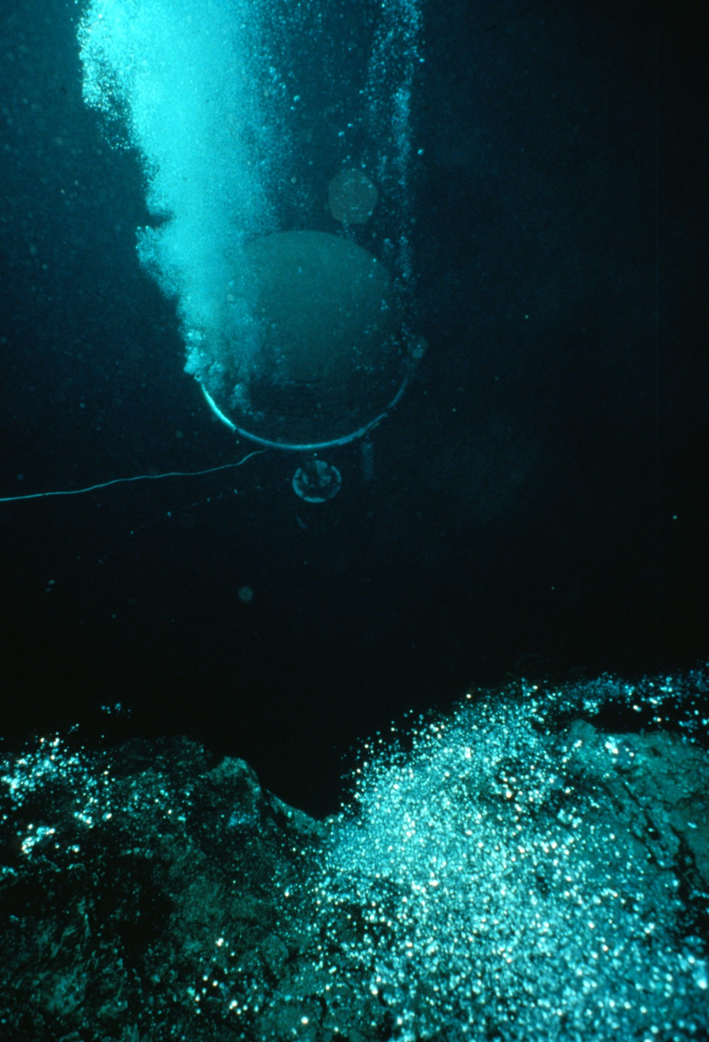
Notes:
During a descent into the spring, the habitat was kept inflated by pumping 125 cubic feet of compressed air per second into the pneumatic shell. This was a critical safety procedure, since otherwise the volume of air inside the shell would compress with increased depth until the entire structure became negatively buoyant and sank uncontrolled. Once stabilized at depth, however, gas was added only for purging carbon dioxide produced by a returning exploration team as they decompressed inside the shell (Gavin Newman)

Slide 50
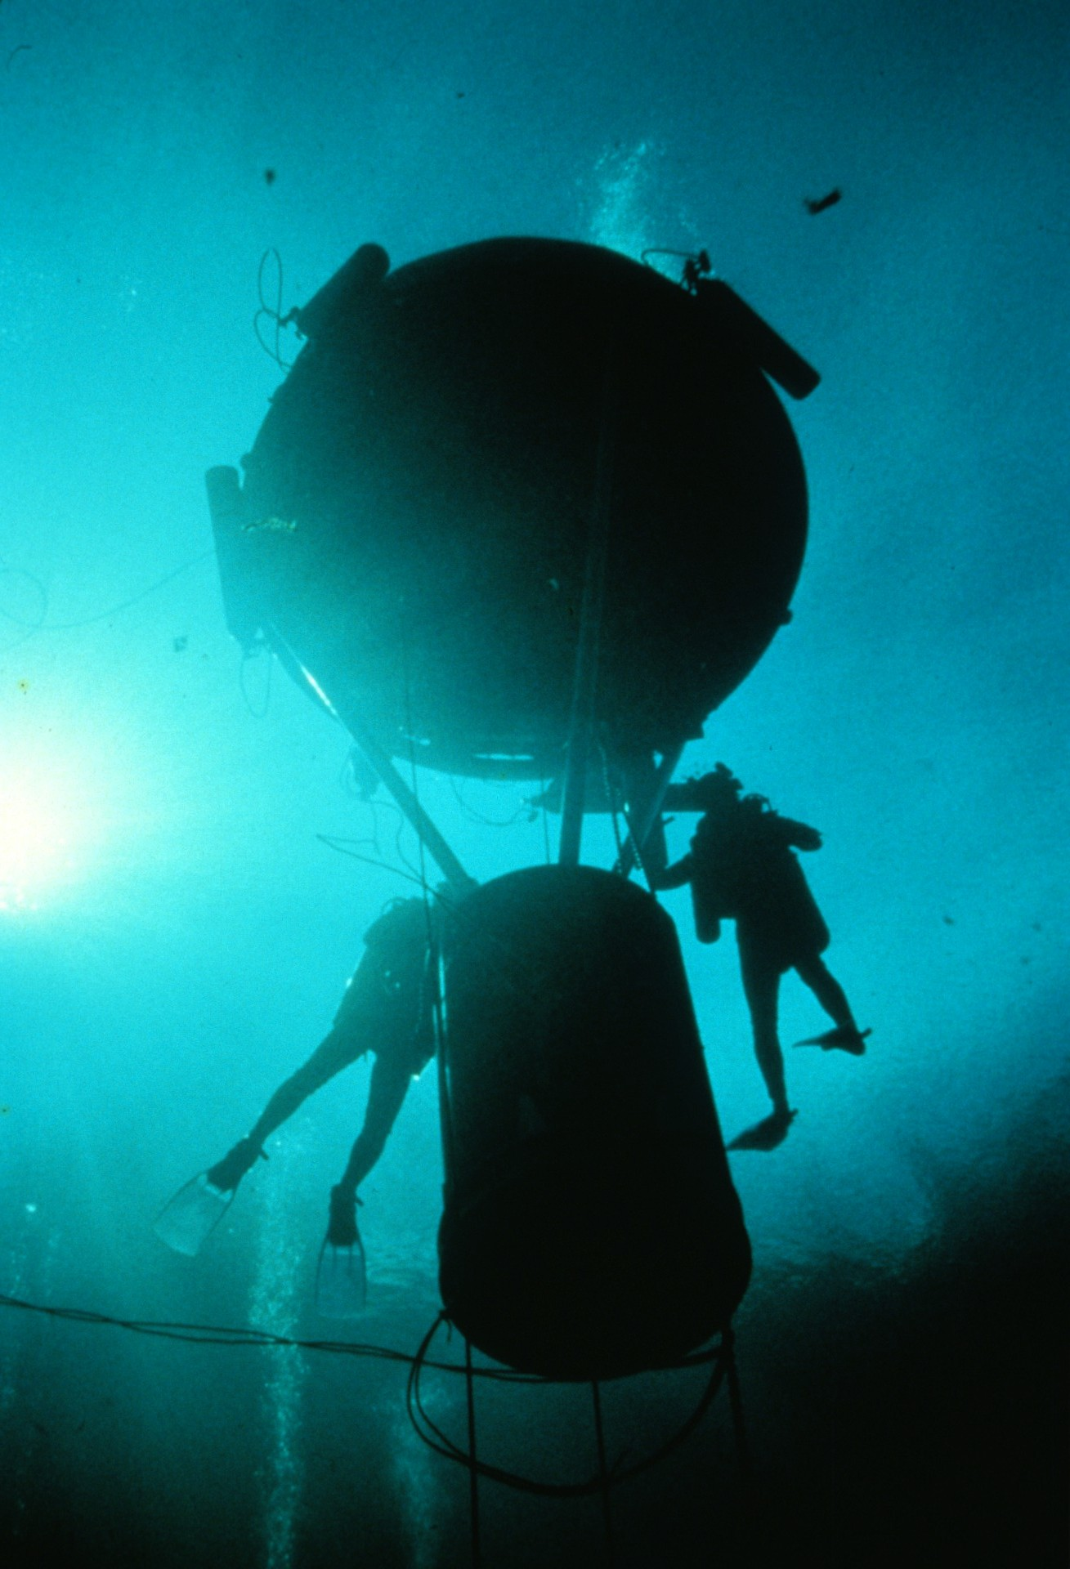
Notes:
Outpost in and Alien World". The habitat at the 60-foot level of Wakulla Spring (Georgette Douwma)

Slide 51
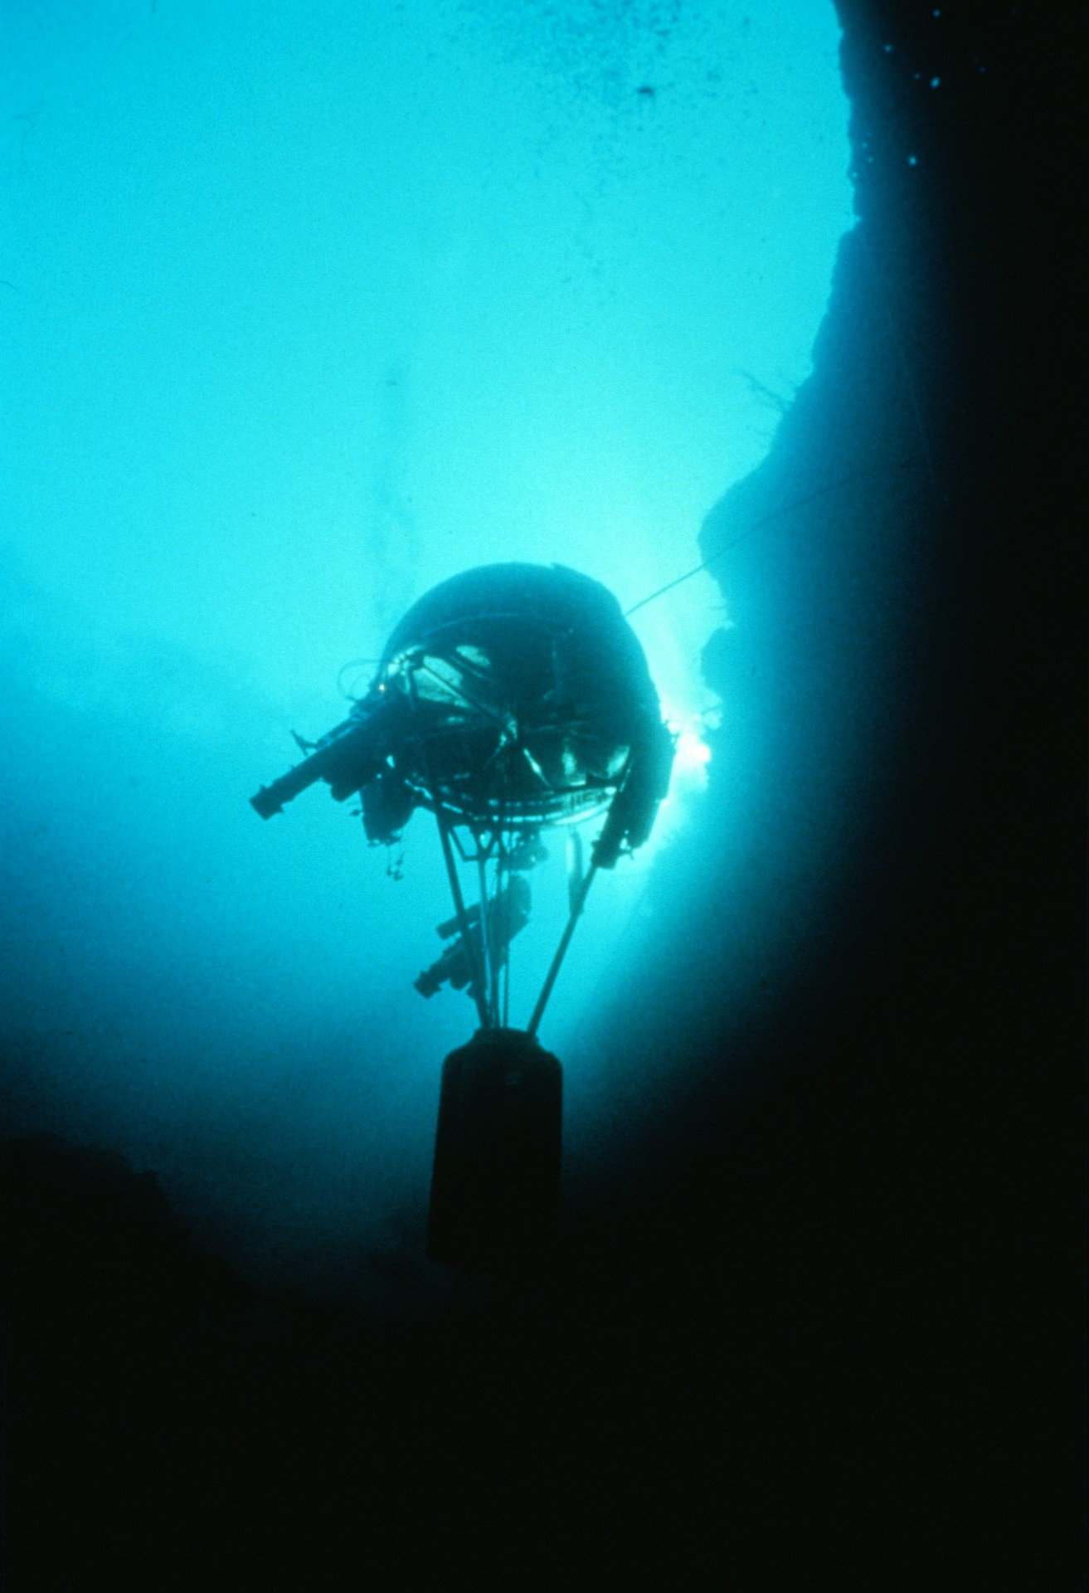
Notes:
The operational habitat at a depth of 70 feet inside the entrance of Wakulla Springs. Up to 6 divers could lock into this chamber at 70 feet depth and slowly raise themselves to the surface to carry out the longest decompression "stops." The divers themselves had complete control of the habitat, no surface control was needed...a first in diving. (Wes Skiles)

Slide 52
Notes:
Paul Heinerth, Wes Skiles, and Clark Pitcairn talk shop at the expedition locker room (Bill Stone)

Slide 53
Notes:
The 9 am meeting: Tanaka, DeLoach, Stone, Skiles, Sloan, and Scoones check the Tallahassee Democrat for the latest news on the project. Regular morning meetings were held to assign daily missions for exploration and support diving teams. (Edward Sheffe)

Slide 54
Notes:
At the expedition office Wes Skiles checks pneumatic hose tolerances for the first of the underwater sleds constructed at Wakulla. The concept involved the use of four composite high pressure cylinders which could be banked and allow the diver to access more than 400 cubic feet of breathing gas without having to switch regulators during a dive. (Bill Stone)

Slide 55
Notes:
Rob Parker, Brad Pecel, and Wes Skiles planning a dive into “B-Tunnel" in Wakulla Spring. Nearly all deep level dives involved surface rehearsals of the mission. This was necessary, given the extremely short time available at great depth, in order to assure high productivity for each mission. (Bill Stone)

Slide 56
Notes:
“High-tech Shipyard": Underwater vehicles being assembled for an exploration mission into Wakulla Spring (Wes Skiles)

Slide 57
Notes:
Parker, Skiles, and Pecel on the beach at Wakulla prior to a mission into B-Tunnel (Wes Skiles)

Slide 58
Notes:
Diver Wes Skiles inspects the "Starship Enterprise" prior to an exploration mission into Wakulla Springs. Two DPVs were outfitted in this fashion at Wakulla (Bill Stone)

Slide 59
Notes:
Exploration diver Paul DeLoach inspects a video filming system attached to one of the diver propulsion vehicles. The submersible is equipped with an onboard Heliox gas supply of 420 cubic feet. DeLoach's appraisal of the filming system: “a clothes-line catcher if ever I saw one.” On the filming mission to B-Tunnel which followed, Wes Skiles proved DeLoach's prediction to be correct: at a sharp corner he was forced to perform an abrupt dive under the guide line...which subsequently was snagged by the camera, flipping Skiles off the DPV. (Bill Stone)

Slide 60
Notes:
A side view of the "Klingon Kruiser", the third of the DPV "sleds” used at Wakulla. (Gavin Newman)

Slide 61
Notes:
Brad Pecel tends to the Klingon Kruiser in preparation for a mission into B-Tunnel in Wakulla Spring. This sled tended to have more drag than either of the two "Enterprises" because of the need to stack the booster gas tanks sideways, rather than one behind the other. (Pete Scoones)

Slide 62
Notes:
Paul Heinerth performs a final pre-dive check on the two 500 watt-second strobe units mounted on Enterprise #2, prior to a filming mission into B-Tunnel in Wakulla Spring (Wes Skiles)

Slide 63
Notes:
British team member Gavin Newman gears up for a support dive at Wakulla Springs. On a typical day only one 3-person team would be exploring below 300 feet depth. However, this team required the support of nearly a dozen additional divers to take the habitat to 70 feet depth, place special Nitrox decompression tanks in the spring and serve as emergency backup. (Sergio Zambrano)

Slide 64
Notes:
Exploration diver Clark Pitcairn straps on his hybrid composite backpack…containing more than 650 cubic feet of Helium-Oxygen breathing gas. The expedition used 86% helium-14% oxygen gas mix for all diving below 200 feet. Because standard Scuba duration decreases greatly at 300 feet (only 1/10 the time at 30 feet) we had to carry massive volumes of gas. (Bill Stone)

Slide 65
Notes:
“Final Checklist:" Exploration divers Wes Skiles (left) and Clark Pitcairn go through their final pre-dive safety checklist before mounting their underwater vehicles for a mission into "C-Tunnel" in Wakulla Spring. Crash helmets and helmet-mounted lights (with the power of aircraft landing lights) were standard operating equipment. Helmet-mounted lights were necessary so that the diver's hands were free to operate the diver propulsion vehicle as well as to perform other tasks such as filming or surveying (mapping). (Bill Stone)

Slide 66
Notes:
An exploration team prepares to submerge for their mission in Wakulla Springs. (Wes Skiles)

Slide 67
Notes:
DPV checkout in Wakulla Basin: A diver nears the crescent shaped rim of the entrance to the spring. To his left the cliff drops directly to -130 feet depth (Wes Skiles)

Slide 68
Notes:
Speed: because breathing gas is used 10 times faster at 300 feet than at the surface, we had to travel faster underwater to effectively carry out exploration. Diver Propulsion Vehicles (DPVs) were the answer. Top speeds of 6 kilometers/hour were possible with an unburdened vehicle. (Pete Scoones)

Slide 69
Notes:
British team member Rob Parker drives his DPV into Wakulla Springs. Equipped with nearly 1000 cubic feet of Helium-oxygen he departs on a 50-minute mission to explore the spring. He will then have to decompress for more than 10 hours. (Paul Heinerth)

Slide 70
Notes:
Like knights of old (or characters from the James Bond movie Thunderball) a three-man exploration team heads for the entrance of Wakulla Spring. (Leo Dickinson)

Slide 71
Notes:
A DPV diver is silhouetted against the entrance of Wakulla Spring. (Bill\Stone)

Slide 72
Notes:
Last sunlight for 12 hours: an exploration team descends towards the entrance of Wakulla Spring. (Wes Skiles)

Slide 73
Notes:
Descending into the gulf. An exploration team is dwarfed by the massive entrance of Wakulla Spring. The tunnel measures 160 feet wide by 130 feet tall at this point. (Wes Skiles)

Slide 74
Notes:
(Wes Skiles)

Slide 75
Notes:
The sand slope seen here begins at a flat bench on the north side of the basin at a depth of 30 feet and extends downward, at the angle of repose, to the entrance restriction at a depth of 190 feet, This photo was taken early in the expedition, prior to placement of the habitat. (Wes Skiles)

Slide 76
Notes:
"Ascent from Inner Space": A support diver begins his ascent to the surface of Wakulla Spring after taking the habitat down to a depth of 20 meters in preparation for another deep exploration dive. Silhouetted around the ring of the habitat's pressurized dome are large capacity oxygen bottles used for later decompression. Pure oxygen was only used at depths above 10 meters; below 10 meters depth the use of pure oxygen can lead to convulsions and, if the diver were outside of the habitat, drowning. Strict safety policies were therefore implemented for marking and placement of all decompression gases. (Noel Sloan)

Slide 77
Notes:
Support divers leave the underwater habitat to place decompression Nitrox bottles at 130 feet depth, (Gavin Newman)

Slide 78
Notes:
Explorer Rob Parker drives his DPV past the waiting habitat for a mission to explore the furthest reaches of Wakulla Spring. (Pete Scoones)

Slide 79
Notes:
The Explorer Cometh:" Rob Parker, nearly hidden within his apparatus, drives into Wakulla Spring with eight Scuba tanks on his motorized sled. With more than 1000 cubic feet (29 cubic meters) of helium-oxygen breathing gas, he is equipped for a mission lasting up to 80 minutes at 100 meters depth. In the distance, the habitat awaits his return. He will be five hours, however, before his decompression schedule will safely allow him to ascend to the depth of the warm, dry pressurized chamber. (Pete Scoones)

Slide 80
Notes:
(Pete Scoones)

Slide 81
Notes:
A three-man exploration team motors into Wakulla. In the distance, a curious crowd of visitors observes through a glass-bottom boat on the surface, 160 feet above; the habitat waits at -70 feet. This type of water clarity has made Wakulla legendary. (Pete Scoones)

Slide 82
Notes:
"Through the entrance Restriction:" At a depth of 60 meters, the massive entrance of Wakulla Spring funnels down to this small 2x3 meter "doorway" through which all explorers must pass. When travelling at a speed of 6 kilometers per hour this became an interesting test of coordination and driving ability. All divers wore crash helmets, too, incidentally. (Wes Skiles)

Slide 83
Notes:
Exploration team negotiates the entrance restriction to Wakulla Springs. (Wes Skiles)

Slide 84
Notes:
Down to business: an exploration team nears the Grand Canyon, 500 feet from the entrance at 240 feet depth. (Wes Skiles)

Slide 85
Notes:
An exploration team 600 feet from the entrance of Wakulla Spring descends into the massive "Grand Canyon:" – a section of tunnel measuring 110 feet wide by 180 feet high. The roof of the passage comes to within 60 feet of the surface in this location – a giant “dome" extends above the divers. In the distance the far wall of the dome is seen descending to a depth of 270 feet where "A-Tunnel", and the main route into Wakulla Spring, continues. (Wes Skiles photo)

Slide 86
Notes:
(Wes Skiles photo)

Slide 87
Notes:
"Journey Into the Unknown:" Two divers ride their diver propulsion vehicles into "A-Tunnel" -- the main passage of Wakulla Spring -- enroute to the frontier. This section of the cave, at a depth of 260 feet and 800 feet from the entrance, was traversed by more than 50 exploration and science diving teams during the project ... a measure of the success in making what was once extremely remote and deep... now routine. (Wes Skiles)

Slide 88
Notes:
An exploration diving team drives through the meandering maze of C-Tunnel at a depth of 300 feet, 1200 feet from the entrance to Wakulla Spring. (Bill Stone photo)

Slide 89
Notes:
Even with 60-foot visibility, a diving team rarely saw more than one wall of A-Tunnel, which typically measured 100 foot wide by 40 foot in height. Consequently, there was a true sense of "flight" when viewing one's partner riding his DPV through the crystal clear void. (Wes Skiles)

Slide 90
Notes:
Rob Parker returns to the habitat following a 50 minute journey into the unknown. (Pete Scoones)

Slide 91
Notes:
"Homeward Bound:" Explorer Rob Parker drives his underwater vehicle towards the habitat following a 50- minute mission into Wakulla Spring. During their dive they explored and mapped 700 feet of new passages at a depth of 310 feet. Their total distance from the entrance was 2600 feet in B-Tunnel. On subsequent missions a distance of 4,176 feet was reached in this tunnel, Before he can ascend safely, Parker must decompress for more than 10 hours. (Pete Scoones)

Slide 92
Notes:
“Drive-in Restaurant:” DPVs are parked outside the habitat while the exploration team relaxes in comfort during the final 10 hours of decompression. (Wes Skiles)

Slide 93
Notes:
“Alligator View of the Habitat:” Inside the comfort of the underwater habitat Paul DeLoach (left) and Sheck Exley bide their time decompressing before they can safely surface some 8 hours later. Five months after this photo was taken Exley descended to a world record depth of 238 meters in Mexico's Nacimiento Mante using techniques developed during the Wakulla Project. At Wakulla Spring, the deepest point recorded was in excess of 110 meters. This, however, was at a distance of more than a kilometer from the entrance to the spring. The Nacimiento Mante is a vertical shaft which descends, not unlike the Fountain de Vaucluse, directly below the entrance. (Wes Skiles)

Slide 94
Notes:
Parker enters the habitat through the pie-shaped entry deck. Tanks were generally stowed on the 5-inch ring beam outside the dome after doffing equipment. The small orange tank on Parker’s right side is a compressed air inflator bottle: inflating his drysuit with the helium-oxygen mixture used for breathing would lead to rapid body heat loss, and possibly hypothermia prior to reaching the habitat (Bill Stone)

Slide 95
Notes:
Divers Paul Heinerth and Tom Morris check their decompression schedules inside the habitat following a stunning exploration to 4,176 feet from the entrance at 320 feet depth in “B-Tunnel.” (Bill Stone)

Slide 96
Notes:
Tom Morris following the 4,176 foot mission: “Yes, I am very happy to be in the habitat!” The habitat was equipped with two telephones (including long-distance service) and had a surface shuttle (a pressurized canister) which was used to deliver dinner at -60 feet on a daily basis. The favorite meal: steak and muffins. (Bill Stone)

Slide 97
Notes:
Bill Stone mans the surface support post on the second level of the diving tower. Two telephones were available for redundancy. One consisted of a “ring-down" closed circuit system; the second included a direct dial conference line which could be used to make long distance calls from the habitat. (Edward Sheffe)

Slide 98
Notes:
Wes Skiles, Rob Parker and Brad Pecel relax in the habitat at -60 feet following a 50-minute dive to 2,600 feet penetration in B-Tunnel (Bill Stone)

Slide 99
Notes:
Tom Morris and Paul Heinerth following the longest dive of the expedition: to 4,176 feet in B-Tunnel. Together with Wes Skiles, this team discovered what is presently the deepest known tunnel in Wakulla: -360 feet at the base of the “Pyramid Room", near the end of B-Tunnel. (Bill Stone)

Slide 100
Notes:
The face of a happy man: Morris, glad to be in the habitat, following an 81-minute mission into B-Tunnel. The decompression for this dive was 10 hours. (Bill Stone)

Slide 101
Notes:
Drs. Bill Stone and Noel Sloan check gas mixture bottles for an exploration mission to Sally Ward Spring. Only 3,300 feet distant from Wakulla Spring, and on the park grounds, the connection of this spring to Wakulla was one of the major goals of the expedition. (Bill Stone)

Slide 102
Notes:
“Hydrilla Horror:” The first obstacle to exploring Sally Ward Spring is the negotiation of Sally Ward Run, a 140 foot struggle through a choking growth of Hydrilla, an aggressive underwater plant. (Leo Dickinson)

Slide 103
Notes:
Through a haze of silt, a diver descends into the diminutive entrance of Sally Ward Spring. (Wes Skiles)

Slide 104
Notes:
"Vortex:" Chief science diver Tom Morris descends through a maelstrom of green haze -- caused by silt stirred up in the shallow surface stream emanating from the entrance to Sally Ward Spring, believed to be connected with Wakulla Spring only one kilometer to the southeast. A substantial current of crystal clear water normally flows out of the entrance, thus keeping the silty water on the surface as Morris descends. In his right hand he is carrying sampling bottles from which water samples were extracted at various depths along the tunnel to determine water quality of the deep level aquifer: the expansion of Florida's capitol city of Tallahassee ever southward has brought concerns that both Sally Ward and Wakulla Spring may someday be polluted by development. (Wes Skiles)

Slide 105
Notes:
"The Entrance Restriction": An 18-inch high squeeze marks the second significant obstacle in Sally Ward Spring. Polished by the cyclone action of artesian water forcing its way up through this restriction, ancient wood debris has been polished into rounded “peanuts.” (Gavin Newman)

Slide 106
Notes:
"Low Passage:” Cinematographer Leo Dickinson forces his way through the 18-inch high entrance tunnel to Sally Ward Spring at a depth of 30 feet. It is a deceptively inauspicious beginning to what will soon be presented to diving teams which make the effort to get through the restriction (see slide number 112). (Gavin Newman)

Slide 107
Notes:
At a depth of 30 feet all divers entering Sally Ward Spring must force themselves through this 18-inch high tunnel. (Wes Skiles)

Slide 108
Notes:
"A Pleasant Day for Flying:" Diver Mandy Dickinson, wife of cinematographer Leo Dickinson, descends through the air-clear 3-meter diameter entrance tunnel of Sally Ward Spring, beyond the 45-centimeter restriction. A hundred meters later she will enter the awesome "Cube Room" (see slide 68). The clarity of the water in Sally Ward spring is so legendary that Florida cave divers have renamed it Uno" (Spanish for Number One). (Gavin Newman)

Slide 109
Notes:
An exploration team traverses the upper level tunnel in Sally Ward Spring. This tunnel averages only 8 feet in diameter… this does not prepare the diver for the awesome discovery he will make 500 feet further into the tunnel. (Bill Stone photo)

Slide 110
Notes:
A science diving team descends the upper level tunnel in Sally 'Ward Spring to collect rock samples to search for a rare species of crayfish. (Wes Skiles)

Slide 111
Notes:
(Wes Skiles)

Slide 112
Notes:
Breakout: the upper level tunnel of Sally Ward Spring hits the roof of the Wakulla Aquifer at a depth of 115 feet, The tunnel below the diving team is more than 120 feet in diameter and descends quickly to over 300 feet depth. (Bill Stone photo)

Slide 113
Notes:
"Phantoms from Inner Space:" A diving team explores the "Cube Room" 500 feet inside Sally Ward Spring. The roof of this immense underwater subterranean chamber is at a depth of only 115 feet. The floor, however, descends to below 300 feet at the base of the rubble slope visible in this unusual photo. To capture the image, photographer Wes Skiles mounted a Nikonos V camera, equipped with a 15mm lens on a tripod, which was held in an upside-down orientation to the roof of the cavern using a container filled with air from a diver's regulator. He then opened the lens as two divers swam into the void. A third companion fired a trigger strobe each time the lens was uncovered. This trigger flash then fired the two much larger (500 watt-second) strobes being carried by the swimming divers. The lens was then covered while they moved further into the cave for the next flash, There are therefore only two different divers in this photo, even though their images have been captured many times! (Wes Skiles)

Slide 114
Notes:
Descent Into the Unknown: an exploration team descends past the 260-foot depth mark in the downstream tunnel in Sally Ward Spring and towards the first downstream restriction. The cave continues an additional 500 feet to a depth of 260 feet and the present limit of exploration. (Bill Stone)

Slide 115
Notes:
Tom Morris searching for crayfish in the entrance tunnel of Sally Ward Spring (Wes Skiles)

Slide 116
Notes:
Procambarus Orcinus: a rare species of troglobytic crayfish found in the furthest reaches of Wakulla Spring. Current theory, based on discoveries made at Wakulla Spring, are that P. Orcinus and P. Horstii, a similar but smaller troglobytic crayfish also discovered in Wakulla, are genetically related. Their presence throughout the Woodville Karst Plain, indicates the likelihood of a grand hydrologic system linked by subterranean corridors. (Gavin Newman)

Slide 117
Notes:
Turf rights are disputed by P. Orcinus in Sally Ward Spring (Gavin Newman)

Slide 118
Notes:
Linda Ann Clemens of the Northwest Florida Water Management District and her field lab at Wakulla Springs. 'Water samples taken from the primary branches of Wakulla Springs during the expedition have been cataloged and will form benchmark data for future comparison as the city of Tallahassee continues to expand southward towards the spring. (Wes Skiles)

Slide 119
Notes:
Diver Wes Skiles (at computer) programs a series of "problems" into the Cis-Lunar MK-1 -- the diving apparatus being worn by Clark Pitcairn in the background. When not in the water the evolution-nary MK-1 could be hooked to an external computer and driven in simulation mode to practice emergency procedures without having to actually be underwater. The MK-1 is a closed-circuit, computer controlled "rebreather" with an efficiency of more than 50 times that of classical open circuit (Cousteau) type apparatus at 300 feet depth. (Bill Stone)

Slide 120
Notes:
Bill Stone (left) instructs Clark Pitcairn in the interpretation of computer generated messages on the MK-1 rebreather (Bill Stone photo)

Slide 121
Notes:
Wes Skiles and Clark Pitcairn run through computer simulations of possible failure modes for the MK-1 rebreather. (Bill Stone)

Slide 122
Notes:
Stone with the microprocessor heart of the MK-1. (Carl Ganter/National Geographic)

Slide 123
Notes:
Stone wheels the MK-1 from the expedition lab to the springs for another test dive. Euphemistically known as "FRED' (for Failsafe Rebreather for Exploration Diving) among the team, the MK-1 weighed 165 pounds and represented a life-support research experiment platform, rather than a true exploration device. (Edward Sheffe)

Slide 124
Notes:
(Edward Sheffe)

Slide 125
Notes:
Sheck Exley and Chris Brown (rear) assist Wes Skiles during kit-up with the MK-1 for a test dive in Wakulla Spring. (Bill Stone)

Slide 126
Notes:
"Apparition from Space:" Diver Wes Skiles tests the MK-1 in Wakulla Springs. (Bill Stone)

Slide 127
Notes:
Space Age Meets Ice Age: Diver Wes Skiles inspects a mastodon thigh bone in Wakulla Basin during a test dive of the MK-1. (Bill Stone)

Slide 128
Notes:
"Blast Off:" Bill Stone tests the MK-1 rebreather in Wakulla Spring. (Wes Skiles)

Slide 129
Notes:
Bill Stone tests the MK-1 in Wakulla Basin. The small stream of bubbles at the rear of the unit was rising from a loose gas connection. When properly tuned, the rebreather released No Bubbles, a bizarre sight to divers equipped with more conventional Scuba. Totally silent in operation, it is essentially a computer controlled portable chemical processing plant. (Pete Scoones)

Slide 130
Notes:
The Shape of Things to Come: Bill Stone inspects the habitat during a night test dive of the MK-1 at -70 feet. Note that no bubbles leave the unit. (Noel Sloan)

Slide 131
Notes:
Bill Stone (left) drops in on diver Paul Heinerth at -140 feet during the deepest rebreather test dive. Heinerth and his fellow teammates had just returned from a 60-minute exploration mission and still had 10 hours of decompression ahead of them. (Wes Skiles)

Slide 132
Notes:
Bill Stone dons the MK-1 for a test dive in Wakulla Spring. Unlike military rebreathers, the MK-1 was designed for safety: it is 16 times less likely to fail than existing systems, due to its failsafe architecture. (Edward Sheffe)

Slide 133
Notes:
Stone performs a final check of the closed-circuit mouthpiece prior to the 24-hour underwater test of the MK-1. (Paul Heinerth)

Slide 134
Notes:
"The Long, Cold Mission:" Bill Stone, equipped with the MK-1 rebreather, patiently reads a paperback book. He has been underwater 7 hours on the planned 24-hour test of the rebreather. (Gavin Newman)

Slide 135
Notes:
Life Support Research: Stone carries out "work of breathing" tests on the MK-1 inside the underwater habitat. (Noel Sloan)

Slide 136
Notes:
At 20 hours underwater, Stone, underwater at lower left, answers questions from the press sent down on a dive slate (Edward Sheffe)

Slide 137
Notes:
“Aftermath of the Long, Cold Mission:" Bill Stone surfaces after spending 24 hours underwater with the MK-1. Calculations of remaining consumables later showed that he could have stayed underwater an additional 24 hours! A newer, more compact version for actual exploration diving has now been designed (the MK-2R) which has a range of 12 hours at 300-foot depth and weighs 65 pounds. (Edward Sheffe)

Slide 138
Notes:
"Victory:” Stone downs champagne following the 24-hour dive. (Edward Sheffe)

Slide 139
Notes:
“Old Glory:" the flag is removed prior to disassembly of the habitat at the end of the expedition. (Tom Morris)
Note: A book entitled “The Wakulla Springs Project,” which describes this expedition used to be available from the National Speleological Society Bookstore, 6001 Pulaski Pike, Huntsville, AL 35810-1122. Tel: 256-852-1300, but is long out-of-print. Copies can be sometimes be found at used book sites.

Slide 140
An NSS Audio-Visual Library Presentation
Wakulla Springs
1987
Original slide program S743
Slides digitized by David Caudle
Script transcribed by Alex Sproul
PowerPoint program created by Jim McConkey
140 slides, with script in presenter notes
PowerPoint created 2/13/2021
National Speleological Society
6001 Pulaski Pike
Huntsville, AL 35810-1122
256- 852-1300
nss@caves.org
https://caves.org/

